Slide 1
Choosing the right one
Present perfect

Slide 2
What have they done?
Read – read – read
He has read a book.
Notes:
NOTE: To change images on this slide, select a picture and delete it. Then click the Insert Picture icon
in the placeholder to insert your own image.

Slide 3
Do – did – done
She has done it
Eat – ate – eaten
She has eaten an ice cream.
Blow – blew – blown
She/he has blown a balloon.
Notes:
NOTE: To change images on this slide, select a picture and delete it. Then click the Insert Picture icon
in the placeholder to insert your own image.

Slide 4
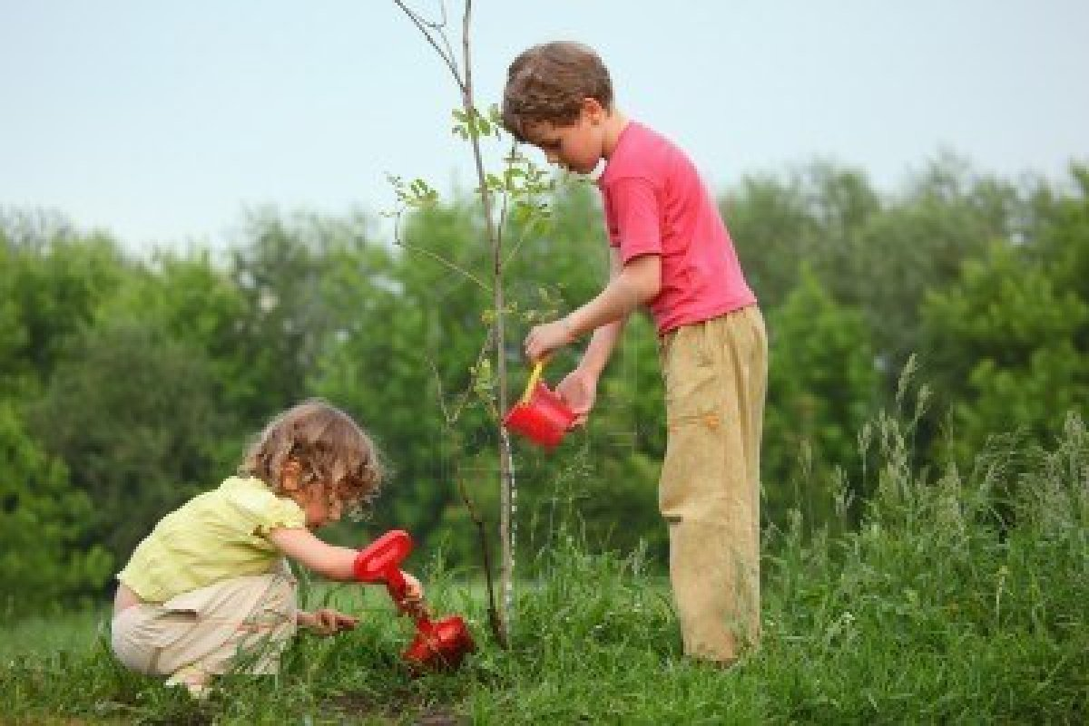
Plant – planted – planted
They have planted a tree.
Take – took – taken
She has taken some photos.
Notes:
NOTE: To change images on this slide, select a picture and delete it. Then click the Insert Picture icon
in the placeholder to insert your own image.

Slide 5
Play – played – played
They have played in the park.

Slide 6
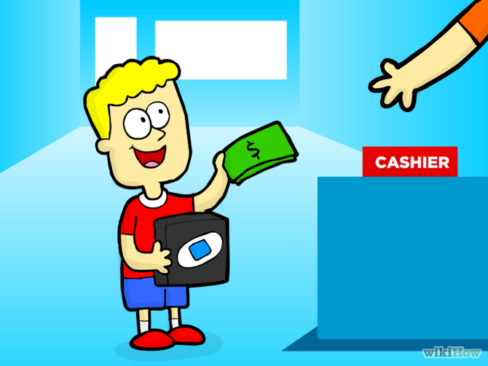
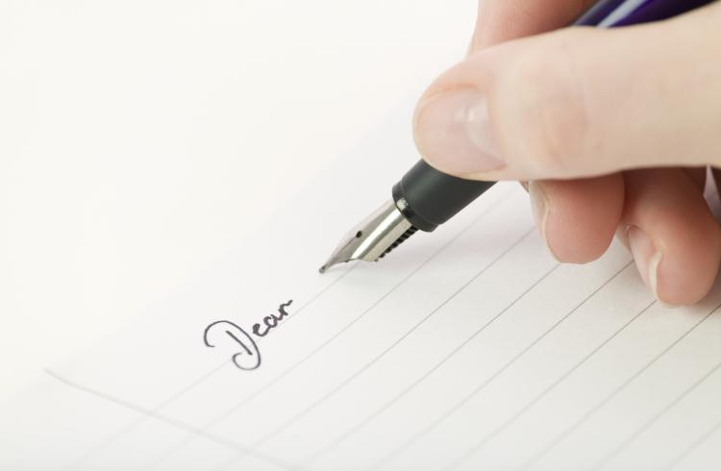
Write – wrote – written
I have written a letter.
Buy – bought – bought
I have bought a video game.

Slide 7
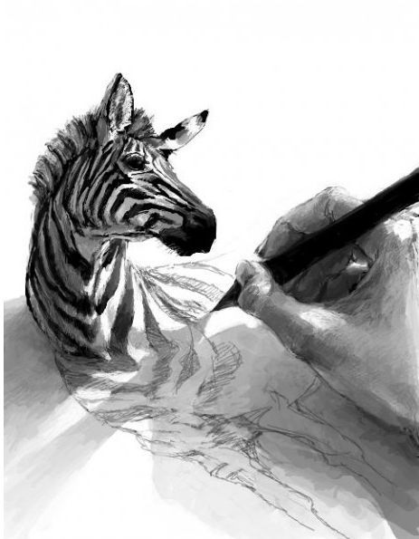
Post – posted – posted
She has posted a letter.
Draw – drew – drawn
They have drawn a zebra.

Slide 8
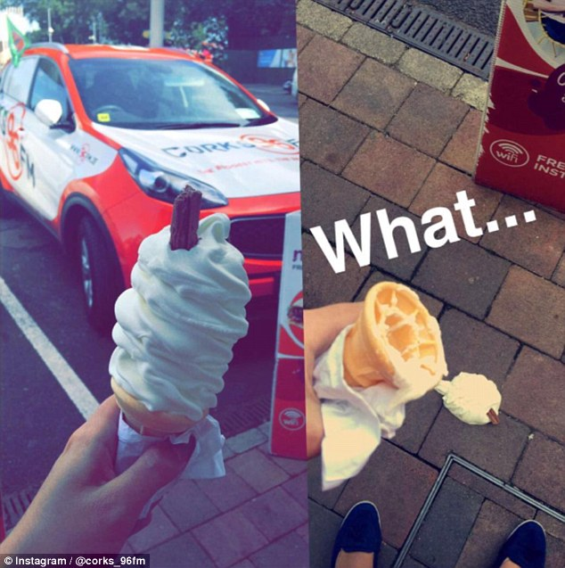
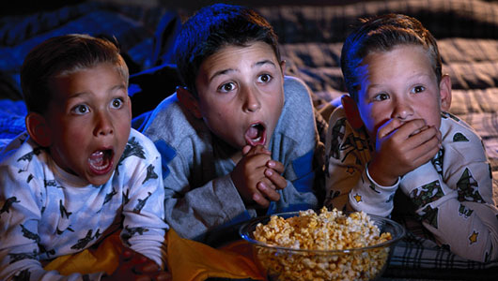
Watch – watched – watched
They have watched a movie.
Drop – dropped – dropped
I have dropped my ice cream.

Slide 9
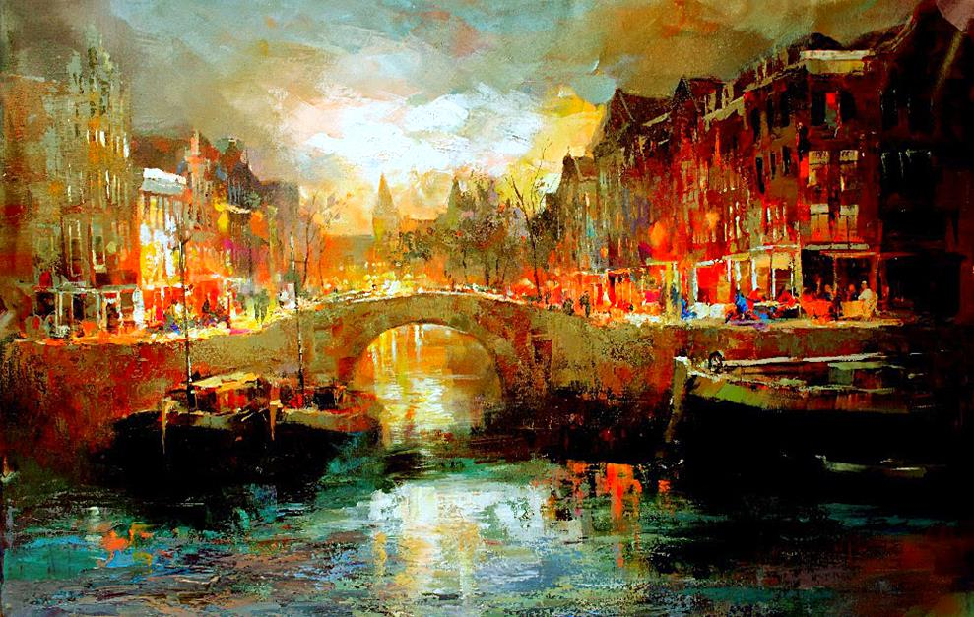
Try – tried – tried
I have tried to ride a bike.
Paint – painted – painted
She has painted a wall.

Slide 10
Sell – sold – sold
I have sold my video games
Reorder – reordered – reordered
I have reordered my desk.

Slide 11
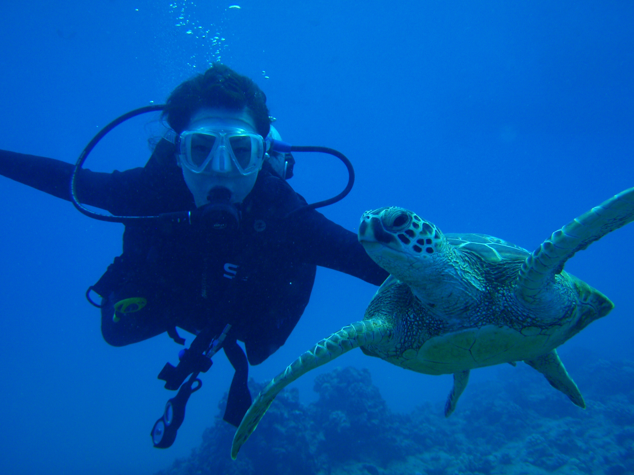
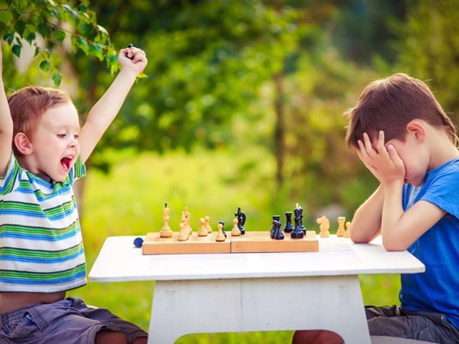
Dive – dove – dived
I have dived with a turtle.
Lose – lost – lost
I have lost the chess game.

Slide 12
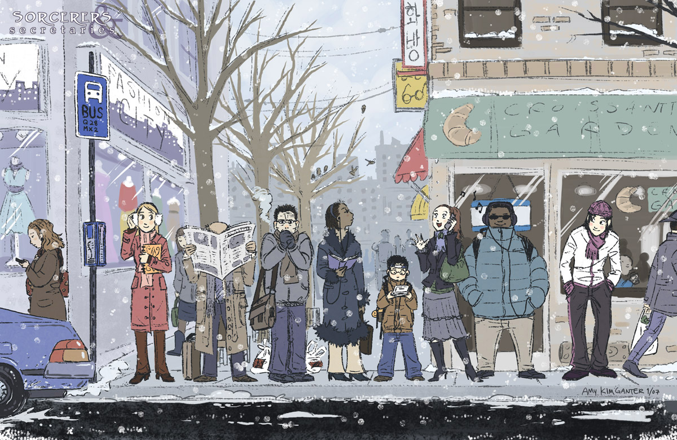
Wait – waited – waited
They have waited for the bus.
Teach – taught – taught
My teacher has taught me science.

