Slide 1
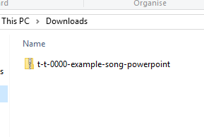
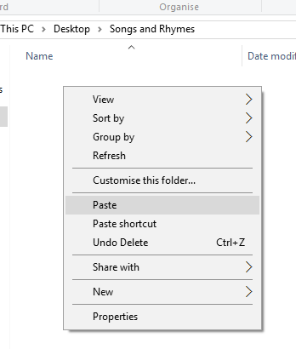


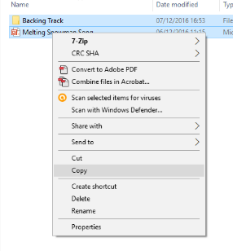
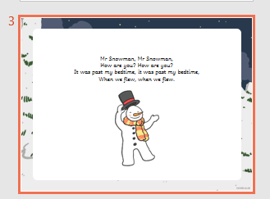
Guidance for Video/Audio in PowerPoints
1. Open the folder and copy all the files.
2. Paste the copied files into a new folder.
3. Open the PowerPoint file, enable editing and enter presentation mode (start the slide show).
Please note the embedded audio may not be compatible with early versions of PowerPoint.
You may wish to delete this slide before beginning the presentation.

Slide 2
OB VSAKEM VOZILU JE ZVOČNIK. S KLIKOM NANJ BOSTE ZASLIŠALI IZGOVORJAVO BESEDE.

Slide 4
S ČIM SE VSE LAHKO PREVAŽAMO?

Slide 5
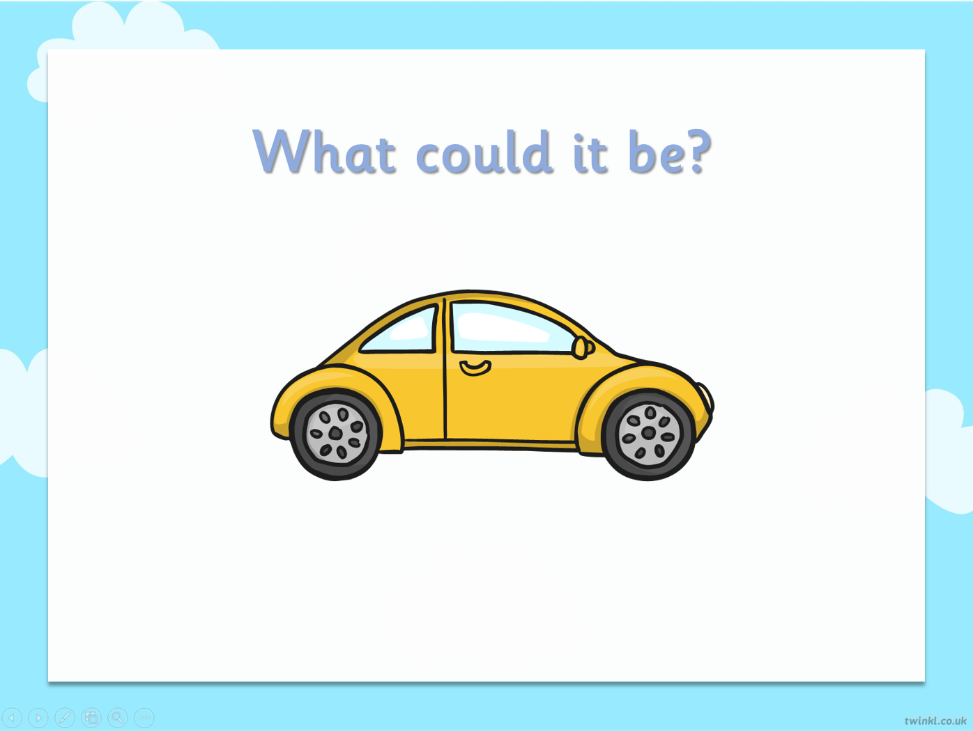

A CAR

Slide 6

AN AEROPLANE

Slide 7

A TRAIN

Slide 8

A BIKE

Slide 9

A BUS

