Slide 1
Ponovitev snovi
2. razred

Slide 2
Katere snovi smo obravnavali na daljavo?
TOYS:
What is it?
Big/small
Old/new
FOOD
What is it?
I like/i don‘t like

Slide 3
1.Toys What is it?
Brali smo zgodbo o mucku Jasperju:
https://www.youtube.com/watch?v=byrVb_QRGC0
2. Spoznali smo naslednje igrače (GLASNO PONOVI):

Slide 4
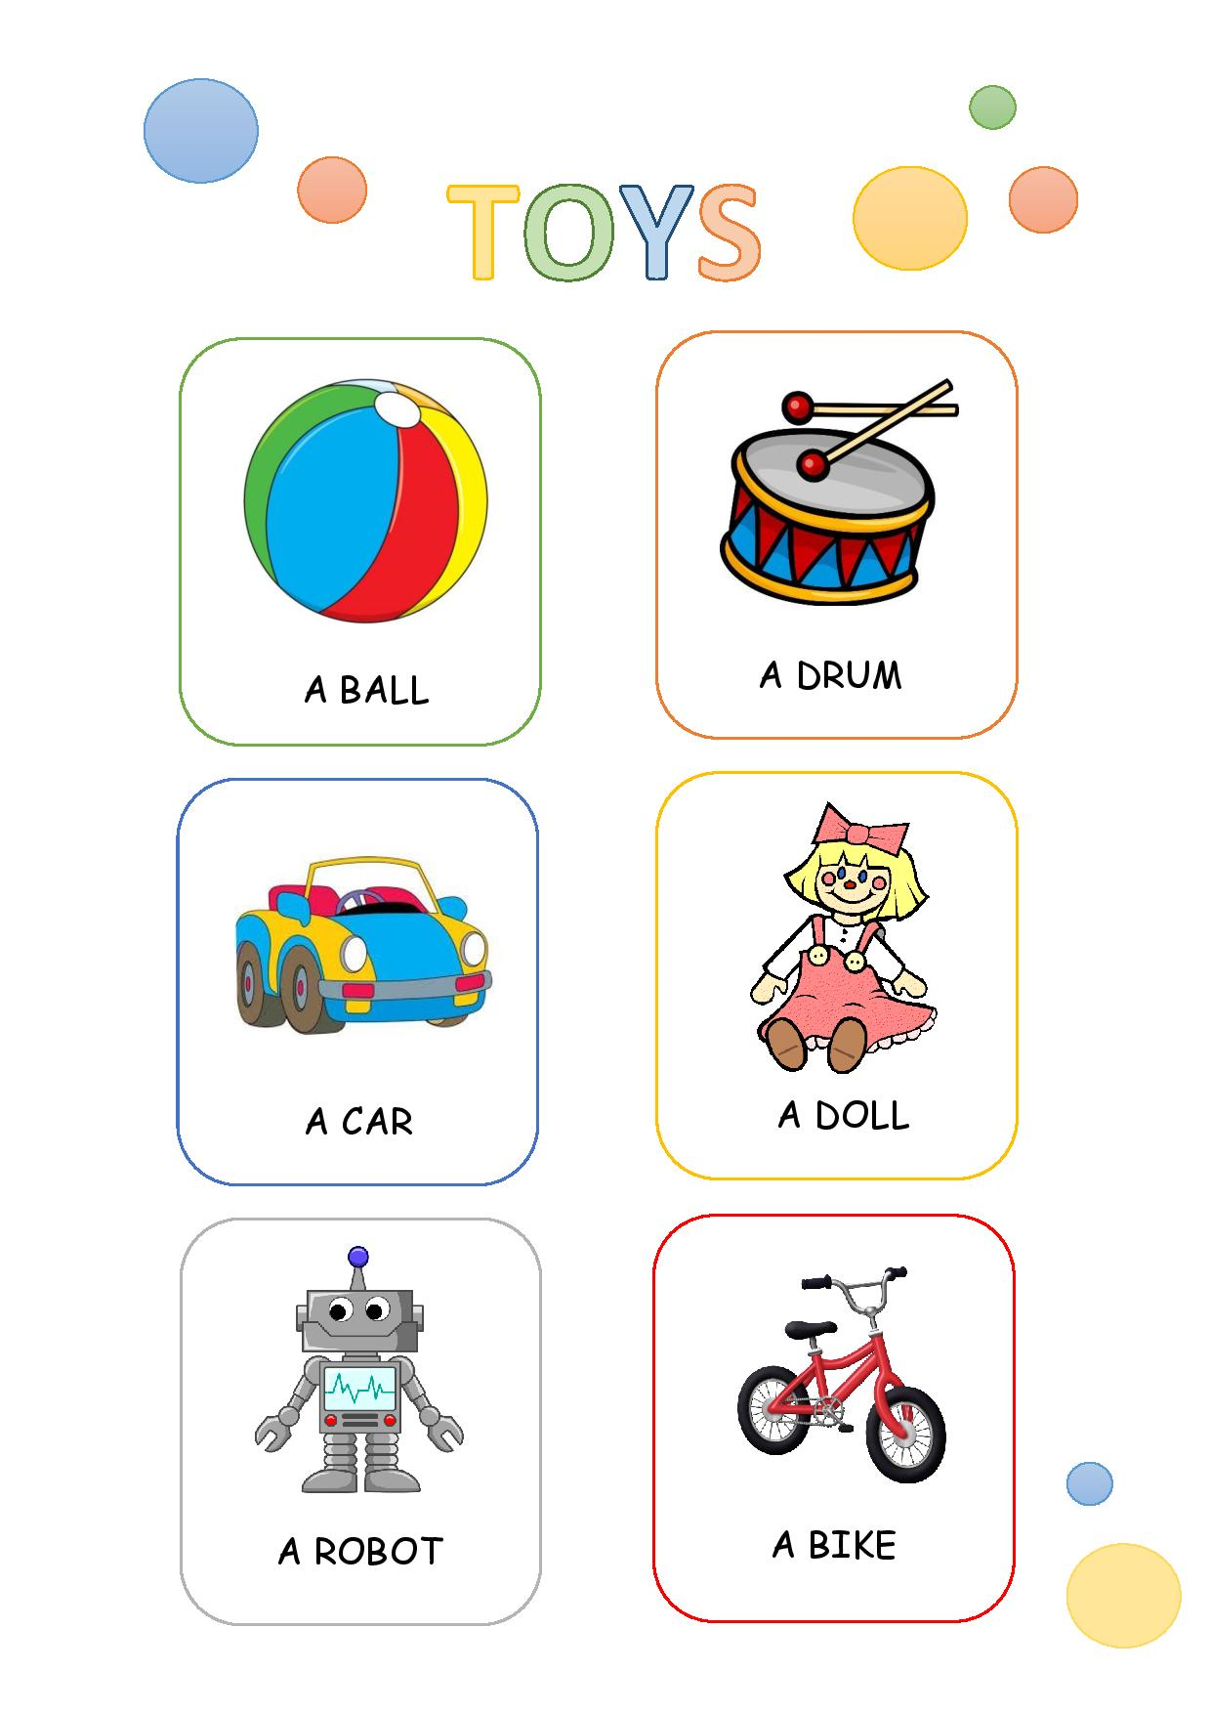
POGLEJ, ČE IMAJO VSI V ZVEZKU TA ZAPIS.

Slide 5
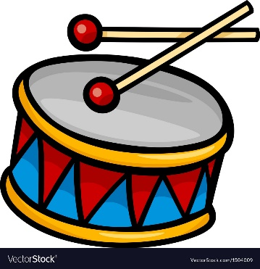
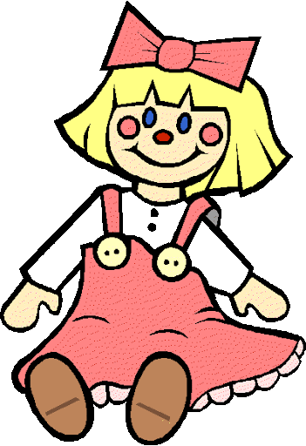
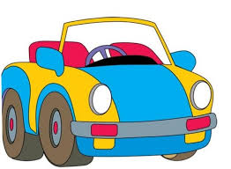
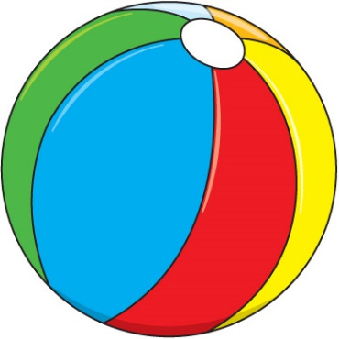
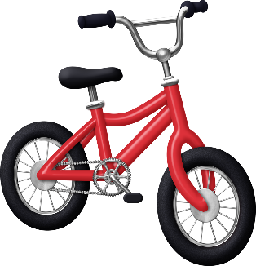
1. V posameznem okvirčku poišči, pokaži in glasno poimenuj:
A DRUM
A BIKE
A CAR
A DOLL

Slide 6
A BALL
A BIKE
A ROBOT
A DOLL

Slide 7
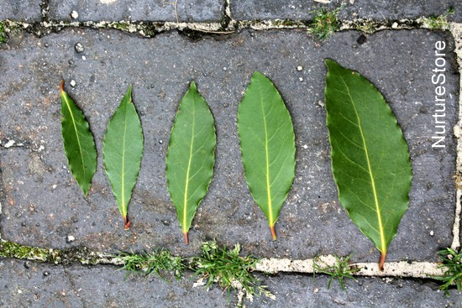
1.Toys big or small?
PELI SMO PESMICO
https://www.youtube.com/watch?v=XAMtgyiUhIo
Naredili ste raziskovalno nalogo
Skupaj ponovimo:

Slide 8
BIG
This baloon is
small
This baloon is
To je MAJHEN balon.
To je
VELIK
balon.

Slide 9
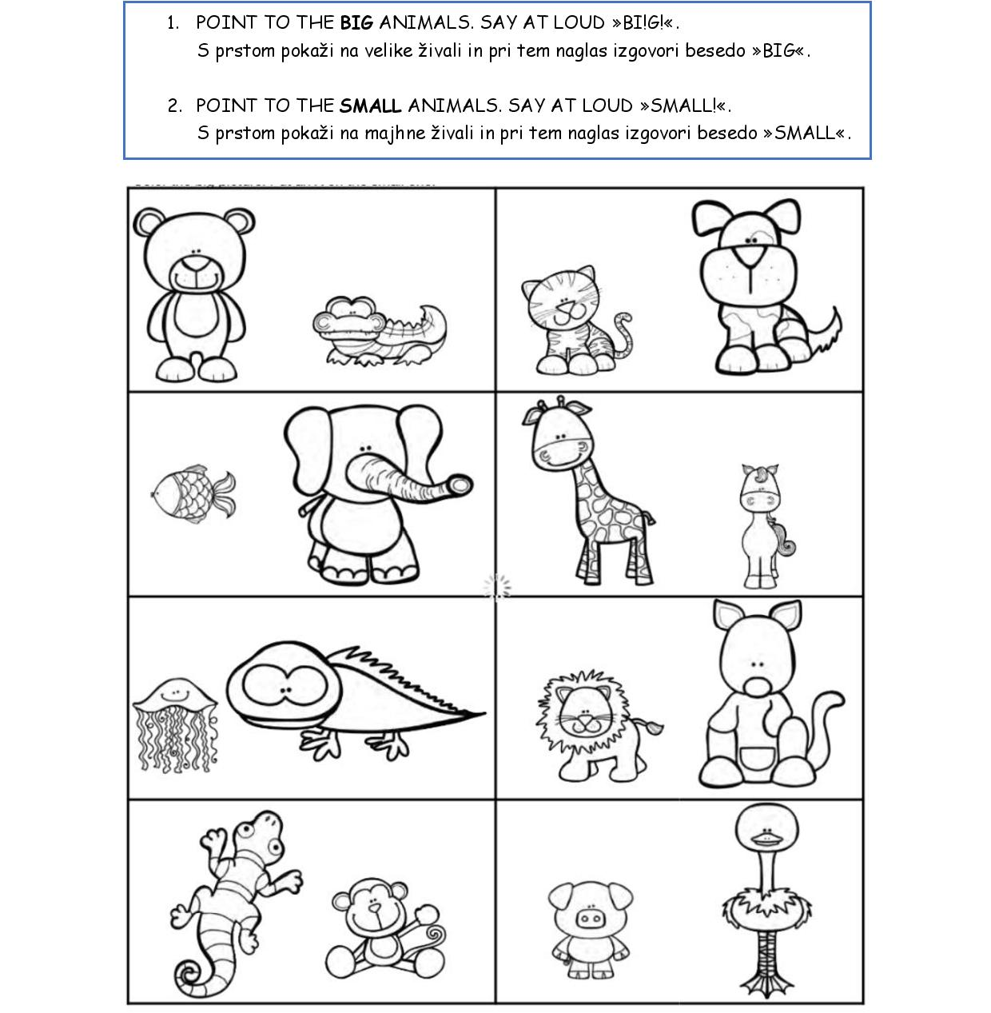

Slide 10
1.Toys old or new?
OLD TOYS
NEW TOYS

Slide 11
Is It Old or New?
old
new
next

Slide 12
Is It Old or New?
old
new
next

Slide 13
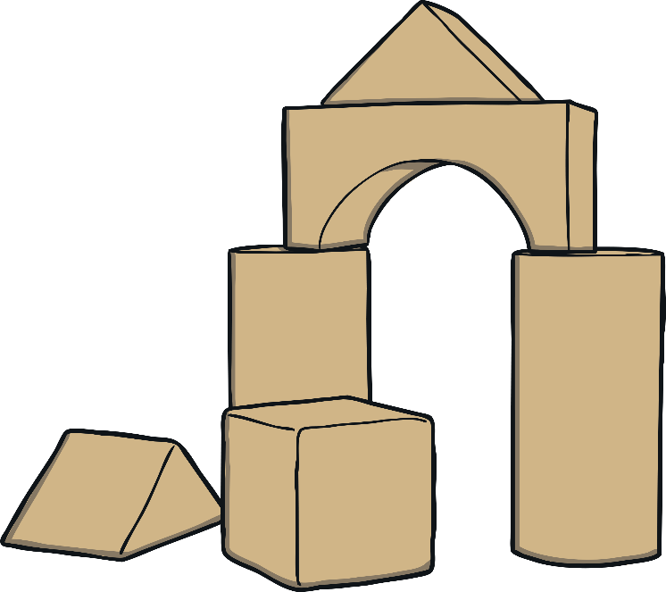
Is It Old or New?
old
new
next

Slide 14
Is It Old or New?
old
new
next

Slide 15
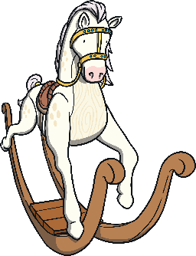
Is It Old or New?
old
new
next

Slide 16
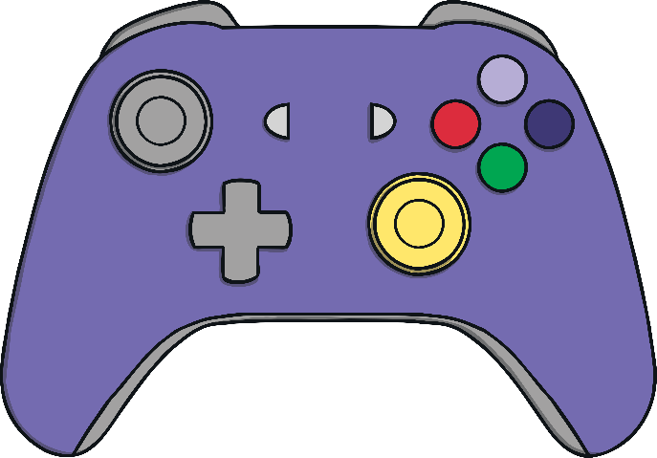
Is It Old or New?
old
new
next

Slide 17
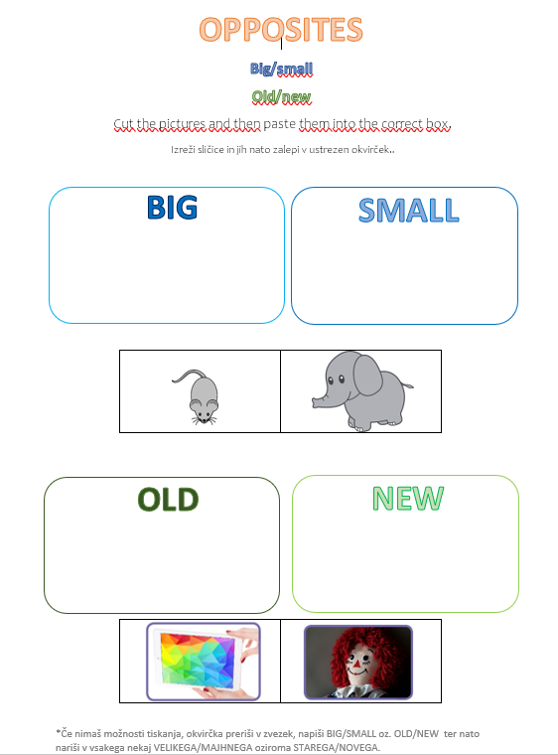
POGLEJ, ČE IMAJO VSI V ZVEZKU TA DELOVNI LIST

Slide 18
2. Food WHAT IS IT?
Poslušali smo zgodbo:
https://elt.oup.com/student/oxfordexplorers/level1/stories/unit5?cc=si&selLanguage=en
Naučili smo se poimenovanja za naslednjo hrano (GLASNO PONOVI):

Slide 19
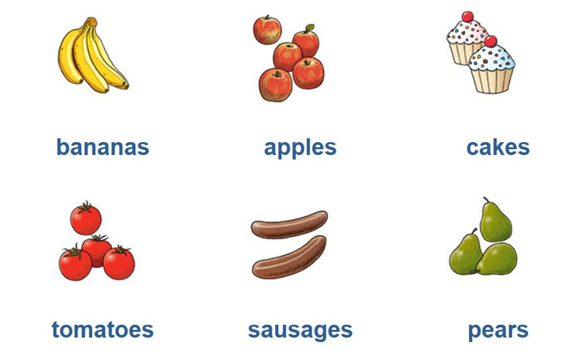

Slide 20
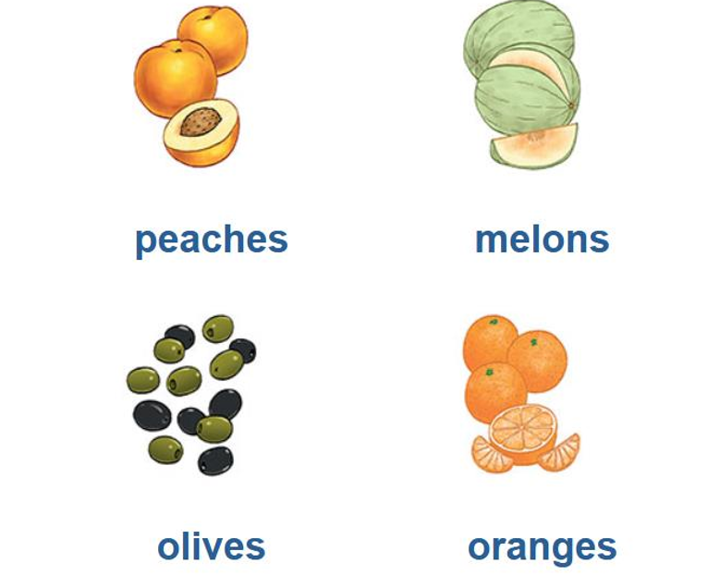

Slide 21
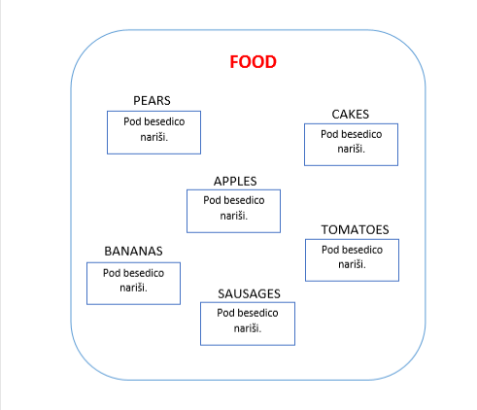
POGLEJ, ČE IMAJO VSI IZDELAN ZAPIS V ZVEZEK.

Slide 22
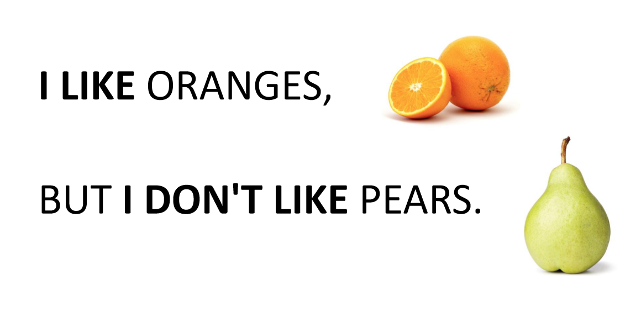
2. Food I LIKE I DON*T LIKE
Pesmica:
https://elt.oup.com/student/oxfordexplorers/level1/songs/unit5?cc=si&selLanguage=en
NAREDI ZAPIS V ZVEZEK!

