Slide 1
BIG OR SMALL? 2. RAZRED
OŠ Šmarje pri Kopru
šol. leto 2020/2021
učiteljica Ena Bissachi

Slide 2
NA VSAKEM DIAPOZITIVU JE ZVOČNIK. S KLIKOM NANJ LAHKO POSLUŠAŠ, KAR JE ZAPISANO.

Slide 3


LOOK AT THE BALOONS.
Oglej si balona.
ARE THEY THE SAME?
Sta enaka?
WHAT IS THE DIFFERENCE?
V čem se razlikujeta?
KLIK ZA ODGOVOR

Slide 4
This baloon is
BIG.
This baloon is
SMALL.
To je MAJHEN balon.
To je
VELIK
balon.

Slide 5
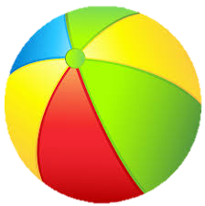
This ball is SMALL.
This ball is BIG.

Slide 6

This guitar is SMALL.
This guitar is BIG.

Slide 7
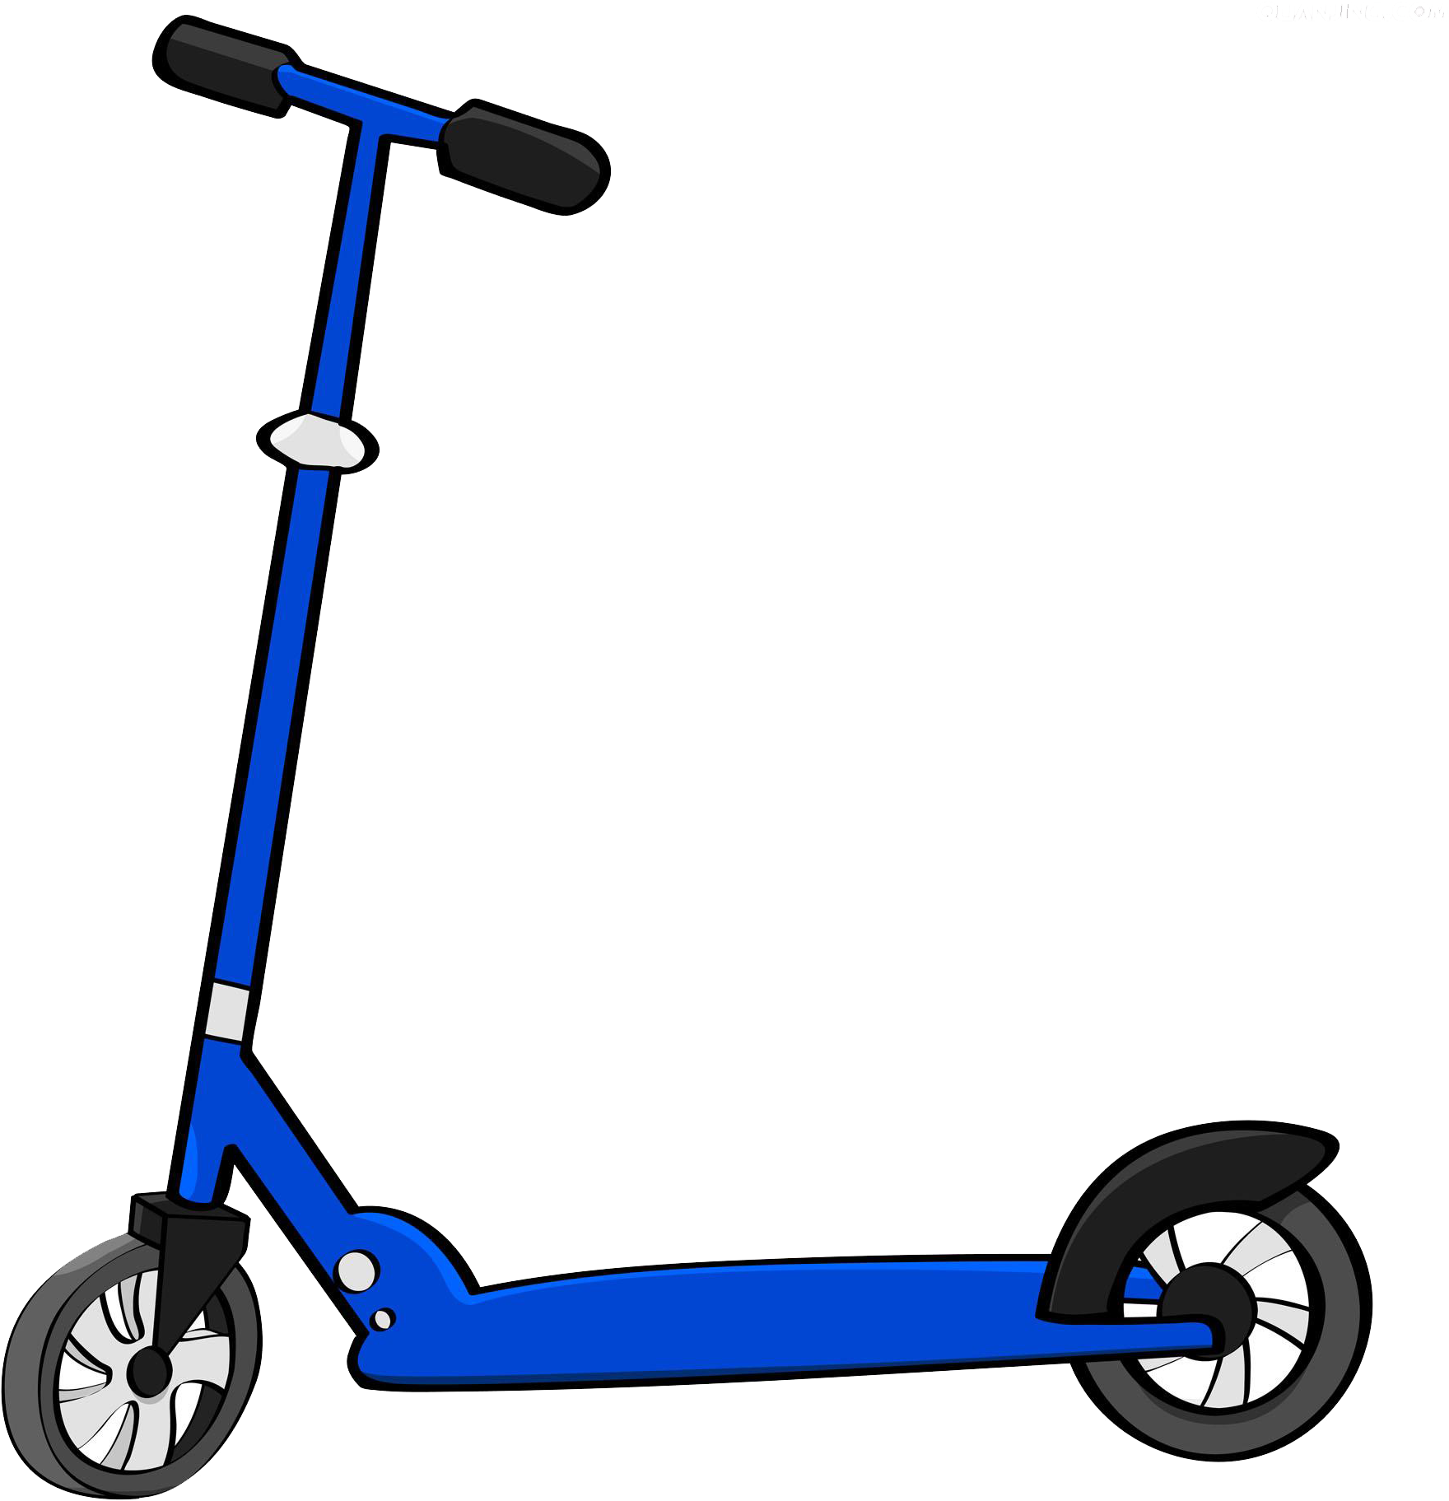
This scooter is SMALL.
This scooter is BIG.

Slide 8
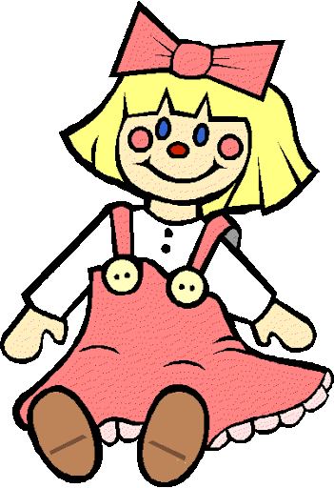
This doll is SMALL.
This doll is BIG.

Slide 9
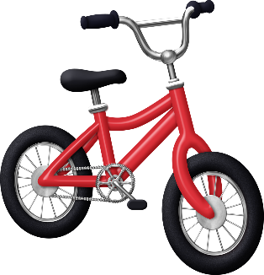
This bike is SMALL.
This bike is BIG.

Slide 10

This car is BIG.
This car is SMALL.

Slide 11
ARE YOU BIG OR SMALL?
(Kaj pa ti, si majhen ali velik?)
You can be both! Watch.
Lahko si oboje! Poglej naprej.

Slide 12
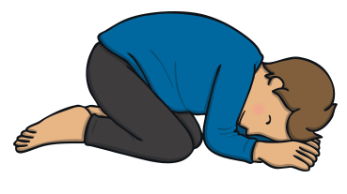
Make your hands small,
Tuck your fingers right in.
Pull in your arms and be really thin.
Curl yourself down to make a ball,
Smile sweetly, whisper “I’m really small”.
Dlani tvoje naj bodo majhne,
Stisni prste naravnost navznoter.
Potegni roke k sebi in bodi čisto ozek.
Zavij se tako, da narediš žogo,
sladko se nasmehni in zašepetaj „Res sem majhen".

Slide 13

Make your hands big,
Stretch your fingers out wide.
Hold out your arms and reach to the side.
Curl your fingers to make a claw,
Frown your eyebrows and do a big roar.
Naj bodo tvoje roke velike,
Raztegni prste na široko.
Roke iztegni močno v stran.
Zavij prste, da narediš kremplje,
Dvigni obrv in naglas zarjovi.

Slide 14
KAJ TI JE LJUBŠE, BITI MAJHEN ALI VELIK? ☺

