Slide 1

IT'S A BIG RED TRAIN …

Slide 2


IT'S A SMALL PLANE.
To je majhno letalo.
IT'S A BIG PLANE.
To je veliko letalo.

Slide 3
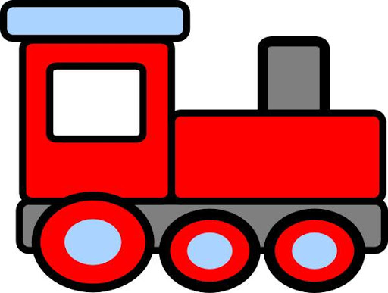
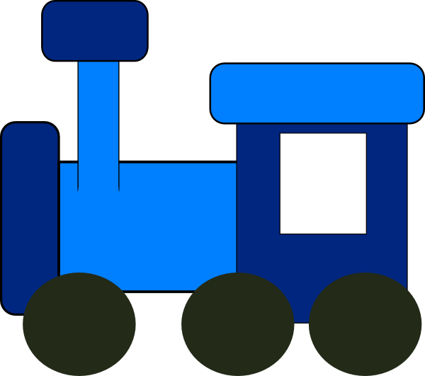
IT'S A RED TRAIN.
To je rdeč vlak.
IT'S A BLUE TRAIN.
To je moder vlak.

Slide 4
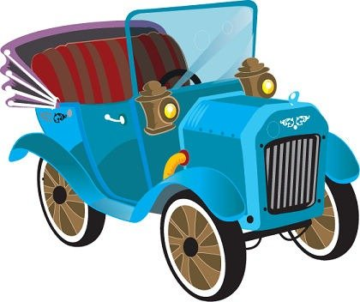
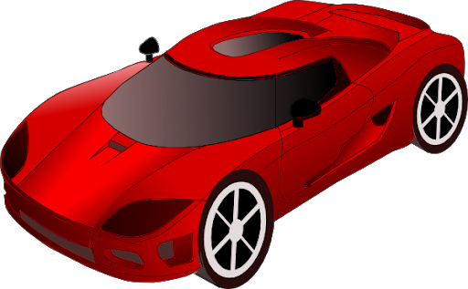
IT'S A NEW CAR.
To je nov avto.
IT‘S AN OLD CAR.
To je star avto.

