Slide 1
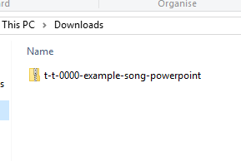
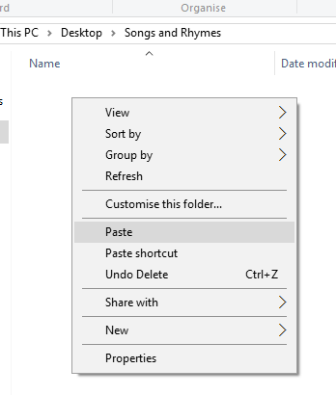


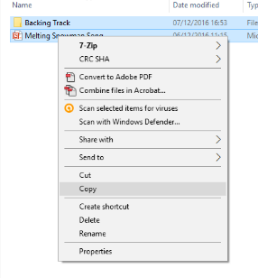
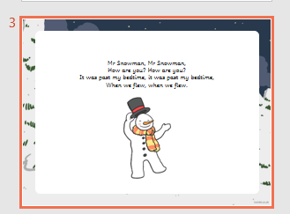
Guidance for Video/Audio in PowerPoints
1. Open the folder and copy all the files.
2. Paste the copied files into a new folder.
3. Open the PowerPoint file, enable editing and enter presentation mode (start the slide show).
Please note the embedded audio may not be compatible with early versions of PowerPoint.
You may wish to delete this slide before beginning the presentation.

Slide 3




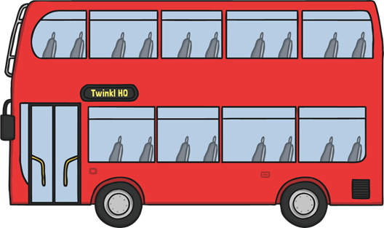
Click a picture to watch the video klikni na posamezno prevozno sredstvo za ogled videa

Slide 4
S ČIM SE VSE LAHKO PREVAŽAMO?

Slide 5


A CAR

Slide 6

AN AEROPLANE

Slide 7

A TRAIN

Slide 8

A BIKE

Slide 9

A BUS

Slide 10
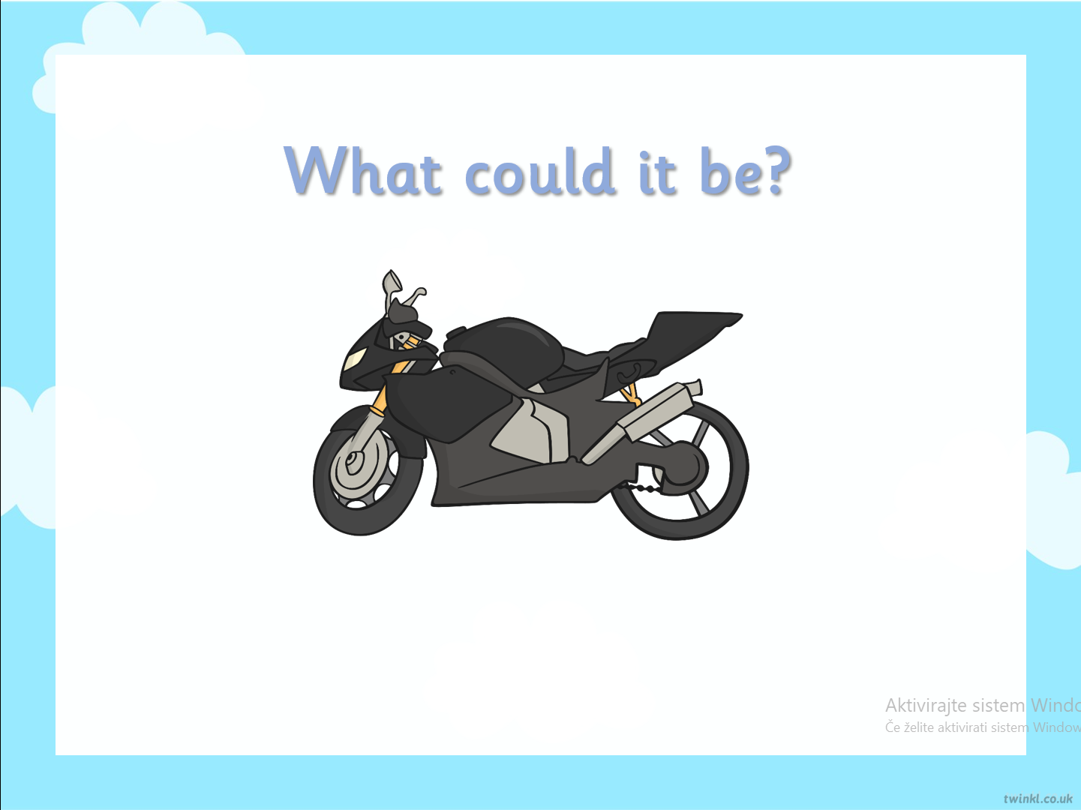
A MOTOBIKE

Slide 11

A TAXI

Slide 12

A BOAT

Slide 13
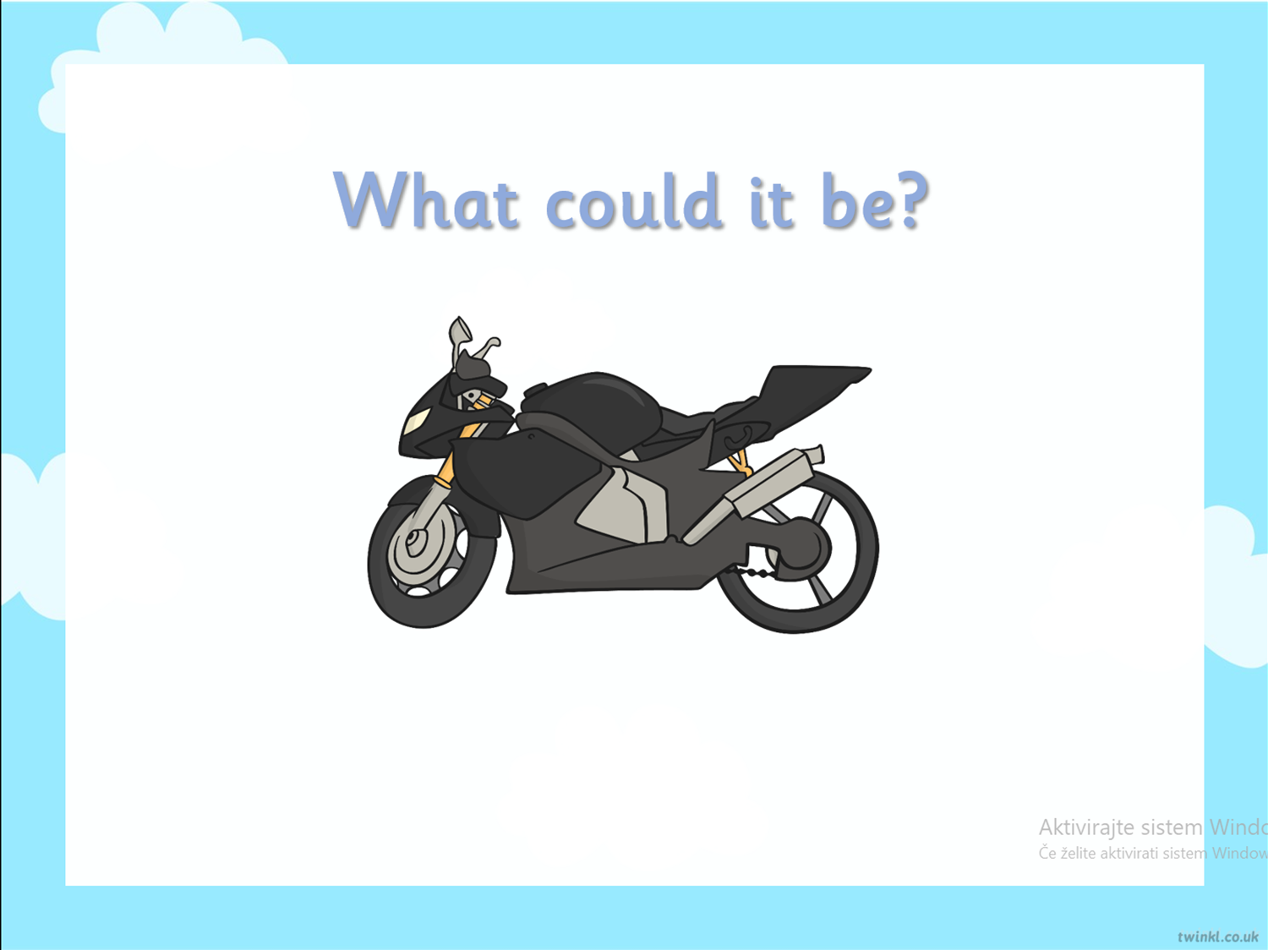

A LORRY

Slide 14









Poskušaj poimenovati prevozna sredstva. Če potrebuješ pomoč, se vrni na sličico in poslušaj besedo.
1
2
3
4
6
5
7
9
8

Slide 15
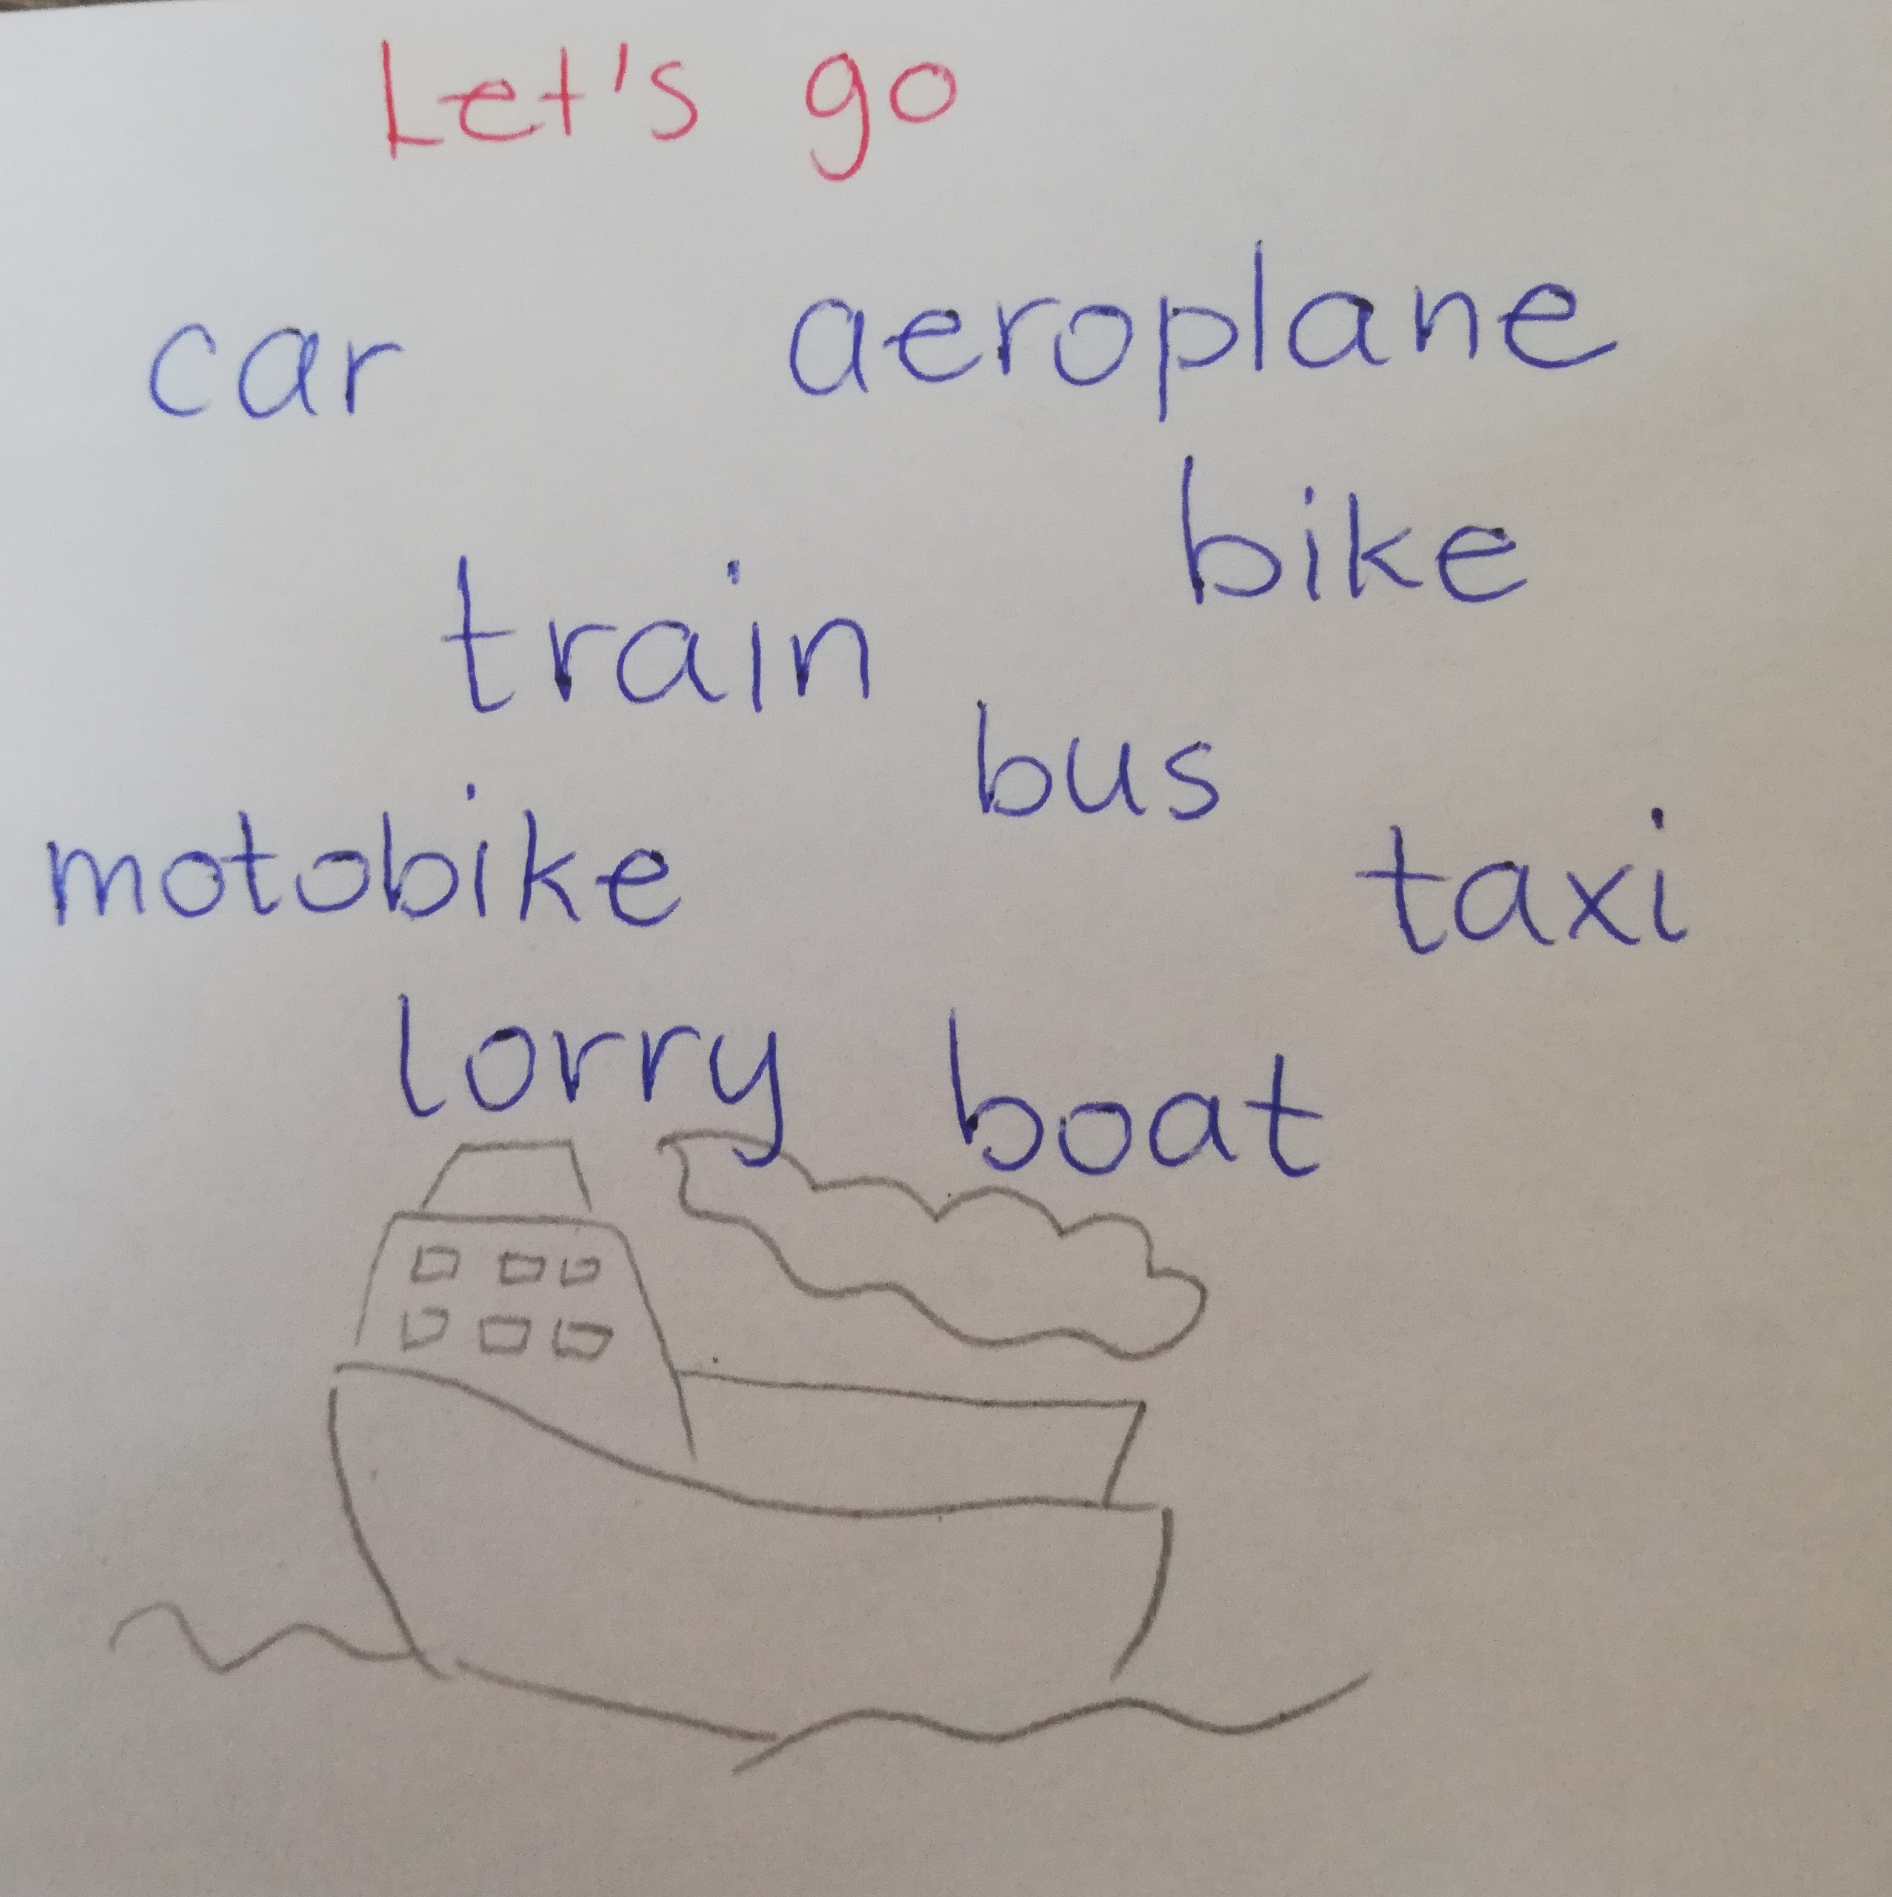
Izdelaj zapis v zvezek
V zvezek zapiši naslov
Let's Go
Zapiši vsa prevozna sredstva, katera si danes spoznal. Enega nariši.

