Slide 2
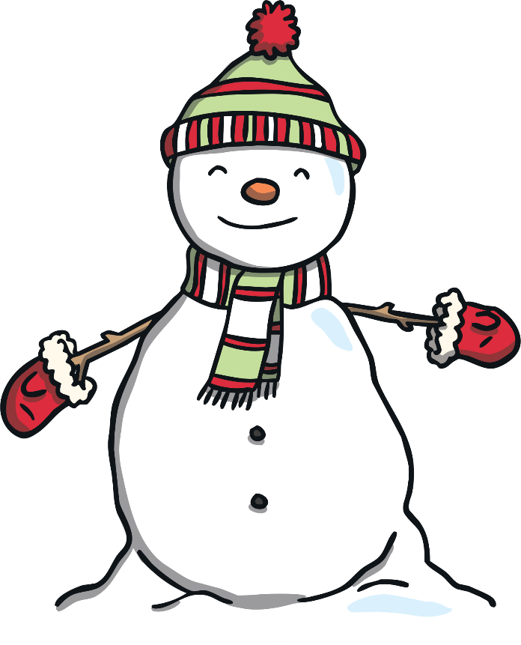
snowman
Father Christmas

Slide 3
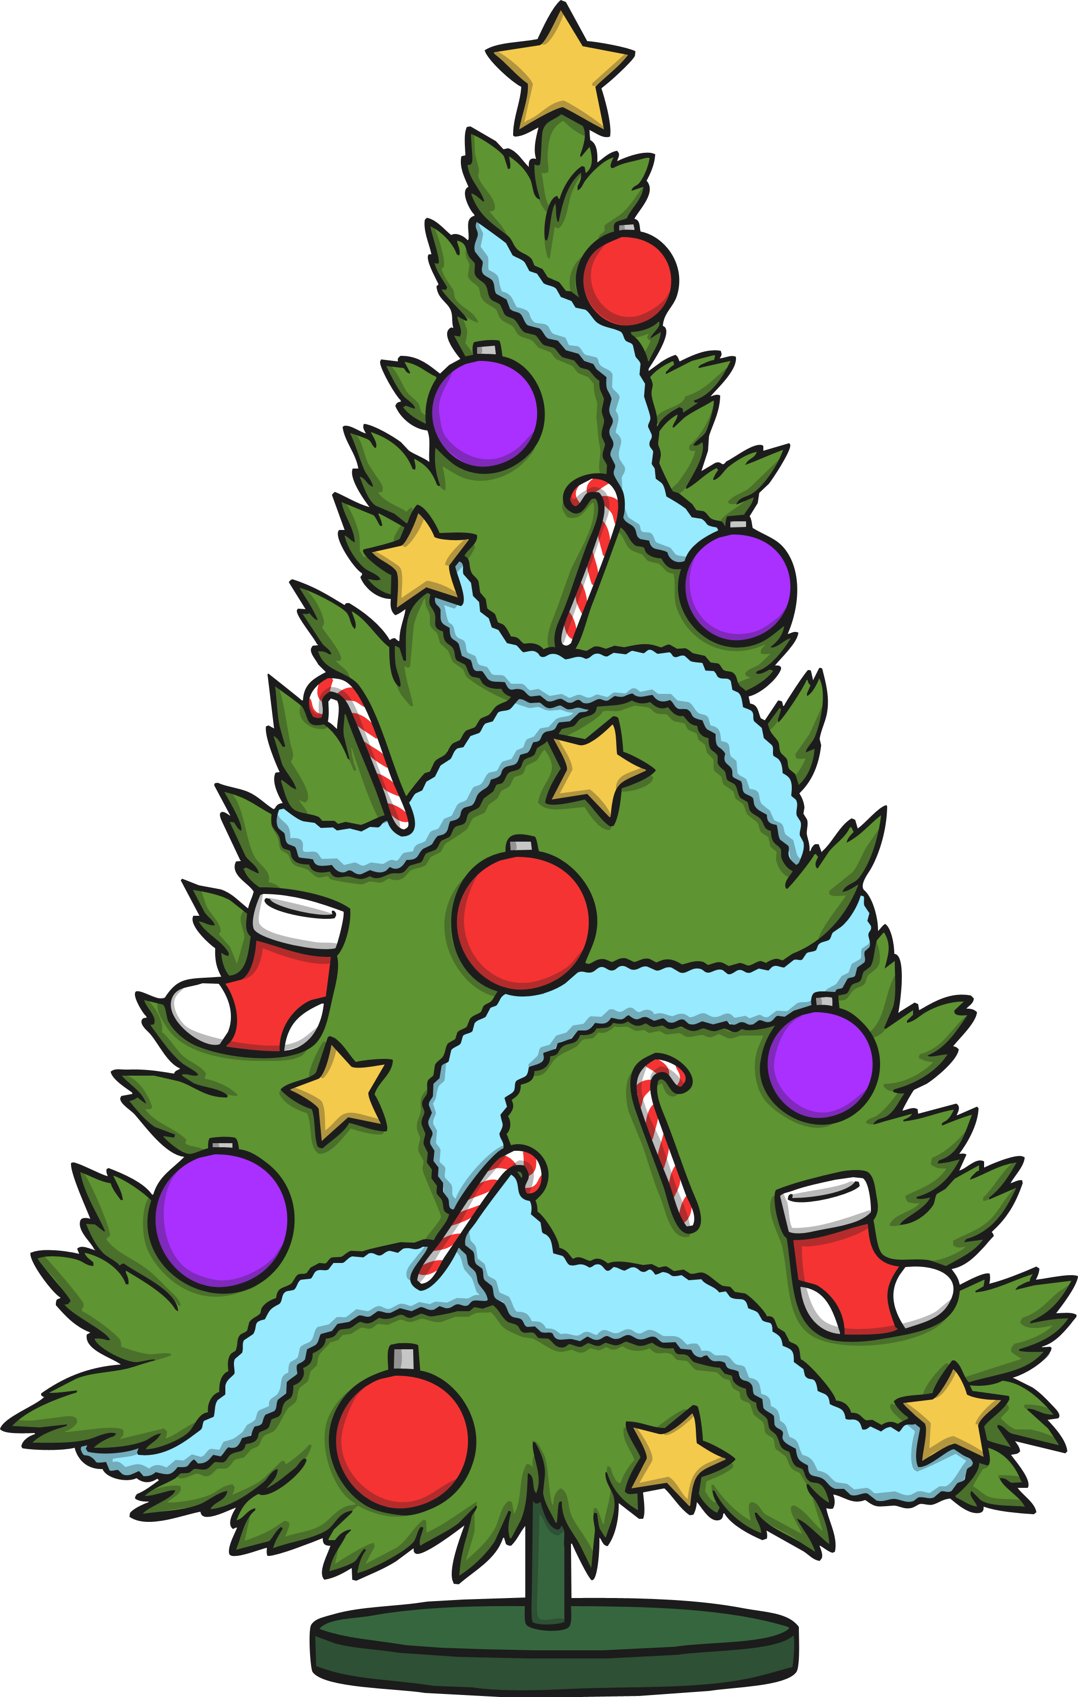
presents
Christmas tree

Slide 4
snowflake
fireworks

Slide 5
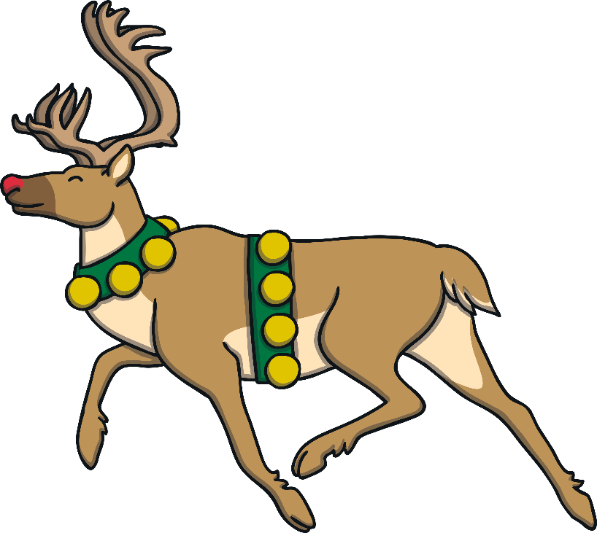
reindeer
bell

Slide 6
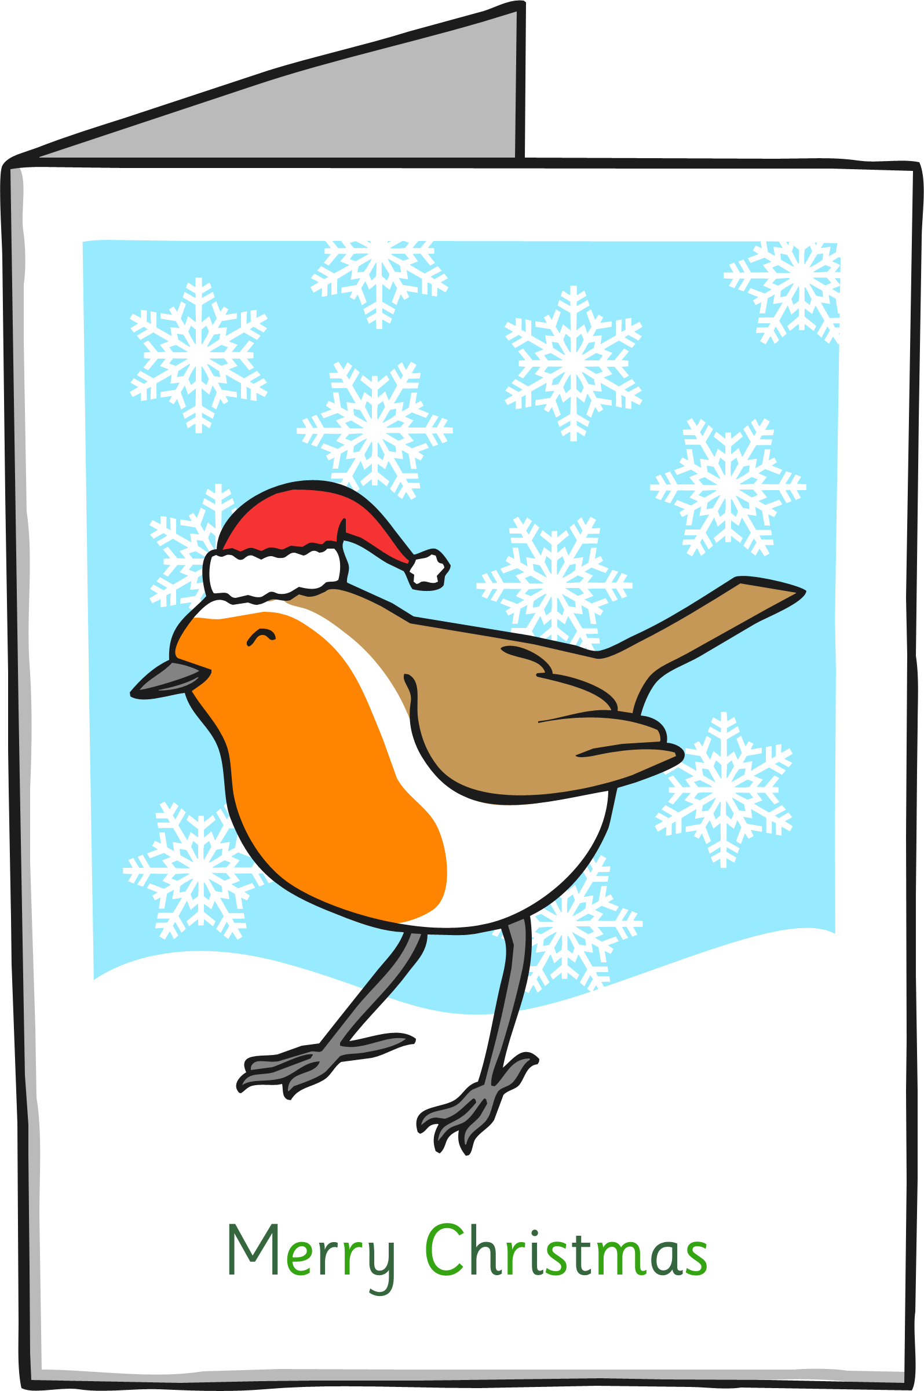
Christmas card
candle

Slide 7
Christmas carols
wreath

Slide 8
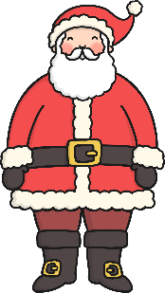
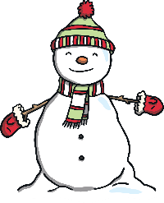
What is it?
Kaj je na sliki? Poimenuj.

Slide 9
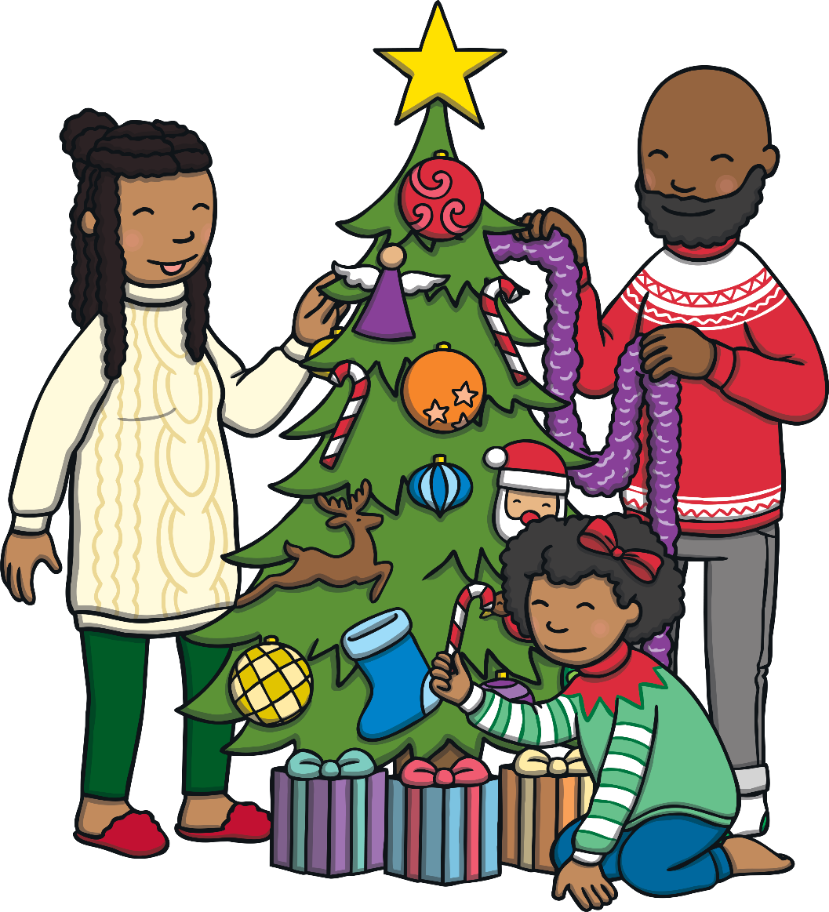
Guess the word game! IGRA: Ugani besedo.

Slide 10
Guess the word!
snowflake
answer

Slide 11
Guess the word!
presents
answer

Slide 12
Guess the word!
Father Christmas
answer

Slide 13
Guess the word!
Christmas tree
answer

Slide 14
Guess the word!
bell
answer

Slide 15
Guess the word!
reindeer
answer

