Slide 1
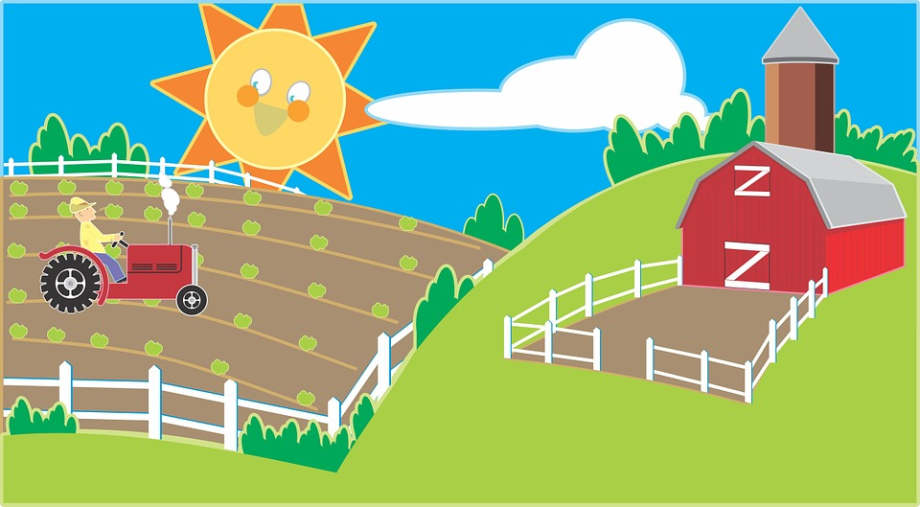
ON THE FARM
Na kmetiji

Slide 2
Classroom Readers
Old MacDonald’s Farm Animals
www.eslkidstuff.com
© Copyright ESL KidStuff

Slide 3
Hello Old MacDonald!
Where are all the animals?
1

Slide 4
What’s that sound?
Which animal is it?
2

Slide 5
It’s a cow!
3

Slide 6
What’s that sound?
Which animal is it?
4

Slide 7
It’s a dog!
5

Slide 8
What’s that sound?
Which animal is it?
6

Slide 9
It’s a pig!
7

Slide 10
What’s that sound?
Which animal is it?
8

Slide 11
It’s a sheep!
9

Slide 12
What’s that sound?
Which animal is it?
10

Slide 13
It’s a duck!
11

Slide 14
What a noisy farm!
12

Slide 15
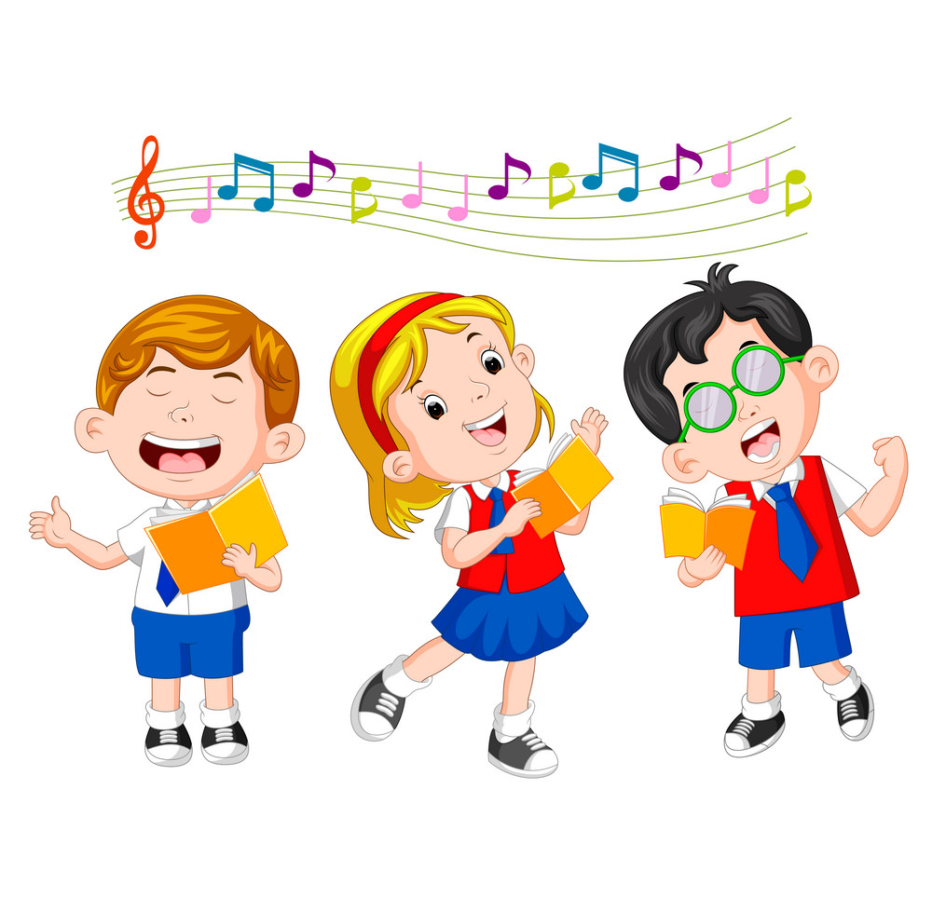
LET‘S SING!

