Slide 2





Can you decide what is an OLD toy and what is a NEW toy?
Ali lahko ločiš, če je igrača STARA ali NOVA?
A NEW toy is a toy that you play with.
An OLD toy may be a toy that your grandparents have played with.
STARA igrača je tista, s katero so se igrali tvoji stari starši.
NOVA igrača je tista, s katero se igraš ti.

Slide 3

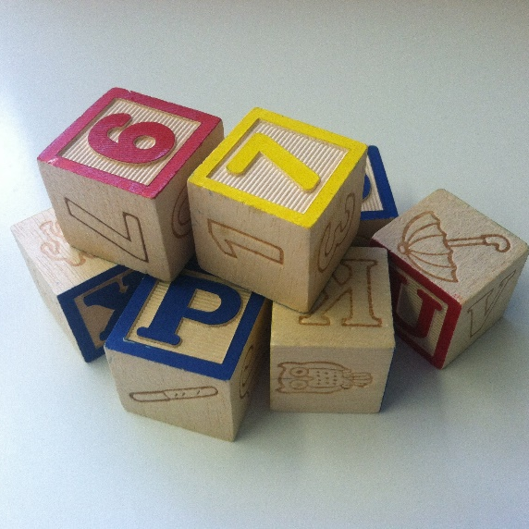
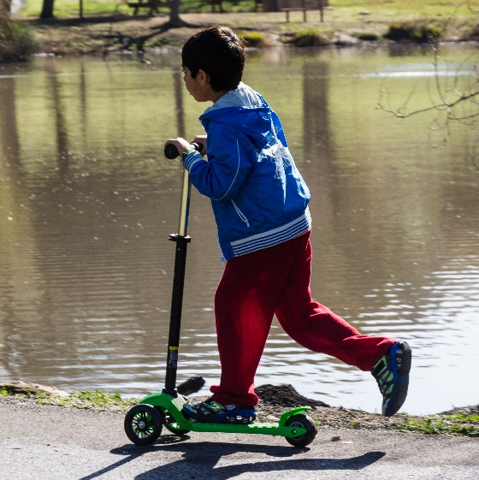

Old or New?
Stara ali nova?
Can you work out which of these toys are old and which ones are new?
Razmisli, katere izmed igrač na sliki so stare in katere nove.

Slide 4




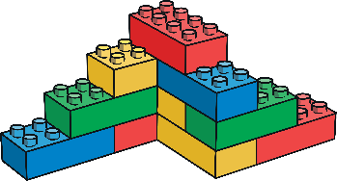
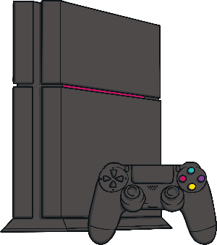




New Toys
Nove igrače
There are lots of different toys in the world. Can you name any?
Zelo veliko različnih igrač poznamo. Lahko poimenuješ katero?
doll
puppets
building bricks
figures
tablet
games console
cuddly toy
electronic toy
bike
football

Slide 5
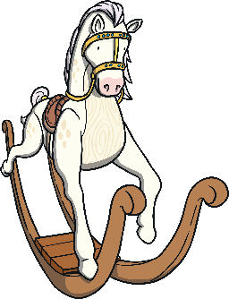











Old Toys stare igrače
Can you name any old toys?
Ali lahko morda poimenuješ kakšno izmed starih igrač?
rocking horse
ragdoll
train set
tin robot
doll’s house
toy soldiers
teddy bear
pull-along toy
marbles
spinning top
roly-poly toy

Slide 6

What Are the Differences?
V čem je razlika?
Old and new toys have lots of differences. Can you think of any?
Razmisli, po čem se stare in nove igrače razlikujejo.
What are they made from?
Iz česa so narejene?
How are they made?
Kako so narejene?
How do they move?
Kako se pomikajo?

Slide 7


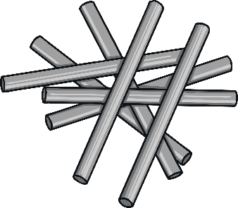




What Are They Made From?
Iz česa so narejene?
Old and new toys are usually made from different materials.
Can you name any materials?
wood
metal
plastic
fabric
Stare in nove igrače so običajno narejene iz različnih materialov. Lahko poimenuješ katerega izmed njih?
cotton
glass
ceramic

Slide 8
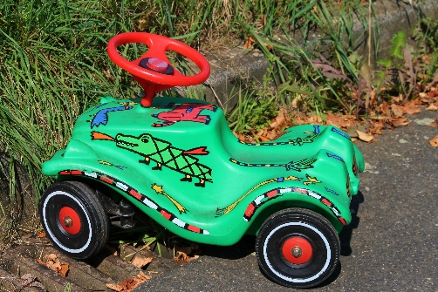
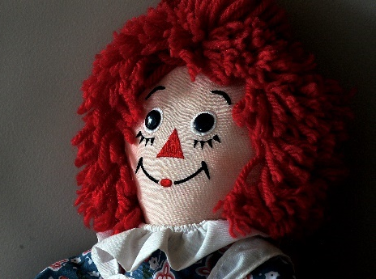
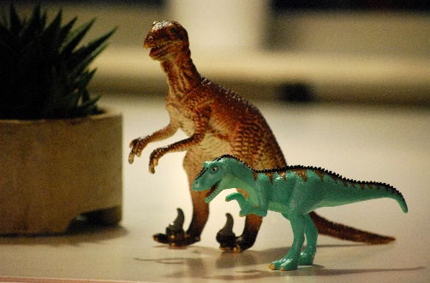
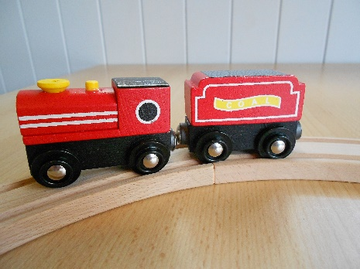
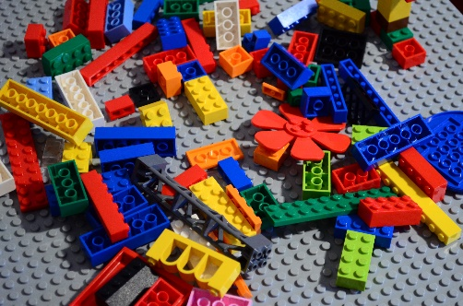
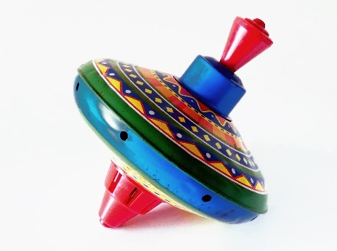
What Are They Made From?
Old toys were usually made from materials such as wood, metal, glass and fabric.
Stare igrače so običajno narejene iz lesa, stekla in blaga.
New toys are usually made from plastic.

Slide 9
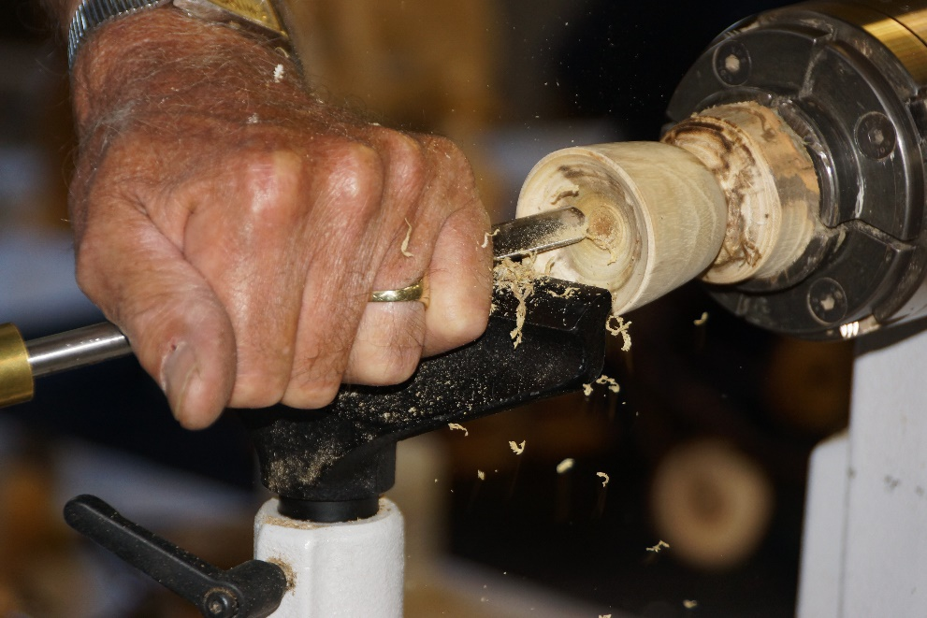
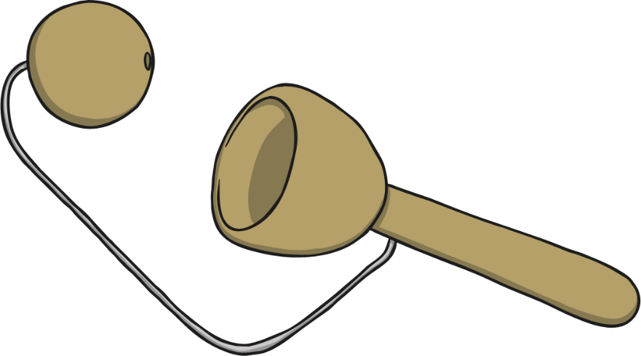
How Are They Made?
Kako so narejene?
Lots of old toys were made from wood. These toys were all handmade. This meant that they took a long time and cost a lot of money to make.
Veliko starih igrač je bilo narejenih iz lesa. Izdelovali so jih ročno, kar pomeni, da so potrebovali veliko časa za izdelavo igrače in ta je bila zelo draga.

Slide 10
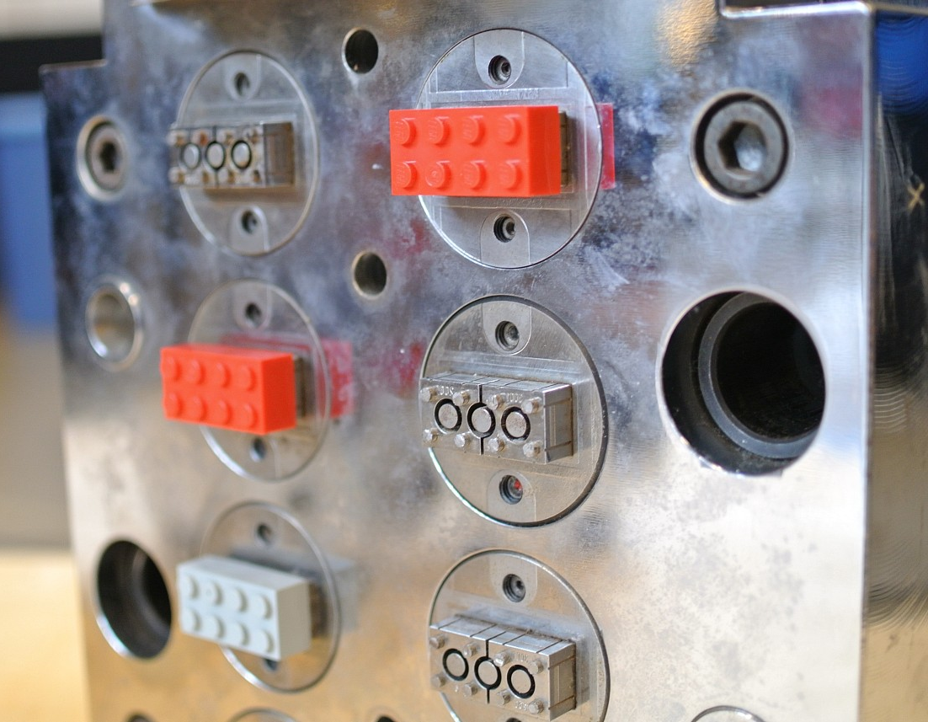
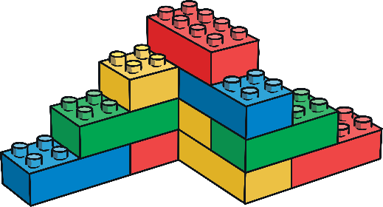
How Are They Made?
Lots of new toys are made from plastic.
Plastic is much cheaper to use.
Toys are mostly made by machines in factories now. This makes the toys much quicker to make too.
Večina današnjih igrač je narejena iz plastike.
Plastika je poceni surovina. Igrače so narejene v tovarnah, kar pomeni, da jih lahko naredijo hitro.
“LEGO World 2013 production area” by [Brickset] is licensed under CC BY 2.0

Slide 11
Take a look at the toys in the pictures on the next slides. Think about them: are they NEW or OLD?
Oglej si igrače na fotografijah na drsnikih, ki sledijo.
Razmisli, ali so igrače NOVE ali STARE.
KLIKNI na rešitev in preveri!

Slide 12
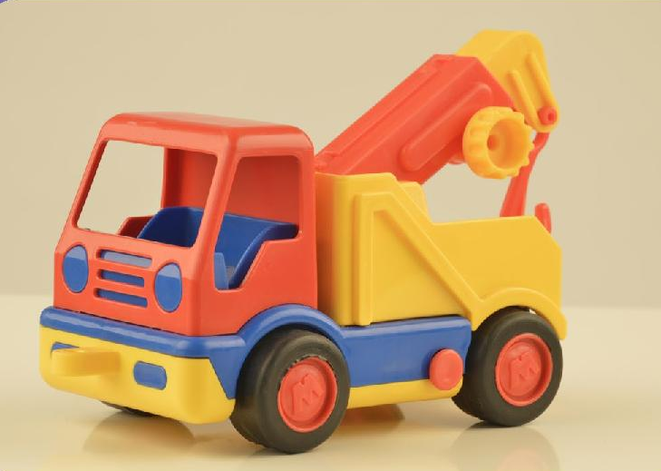
Is It Old or New?
old
new
next

Slide 13
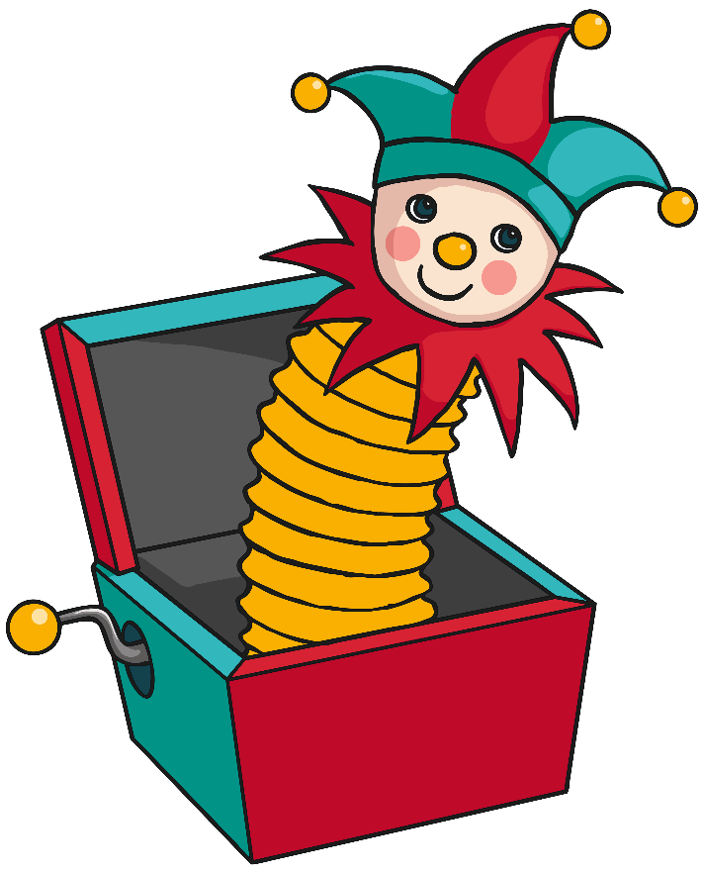
Is It Old or New?
old
new
next

Slide 14
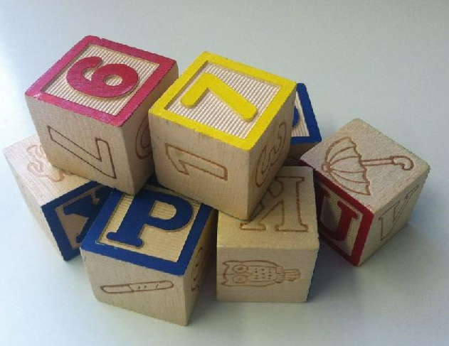
Is It Old or New?
old
new
next

Slide 15

Is It Old or New?
old
new
next

Slide 16
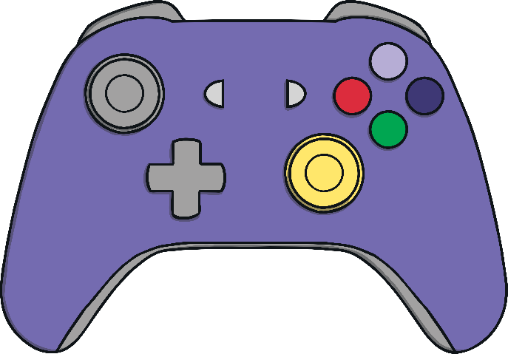
Is It Old or New?
old
new
next

Slide 17
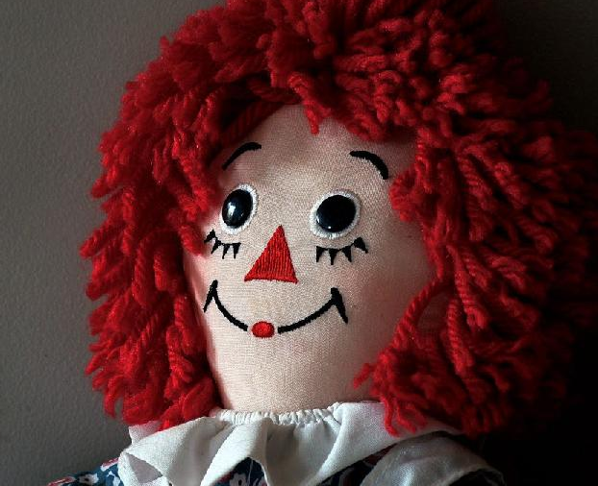
Is It Old or New?
old
new
next

Slide 18
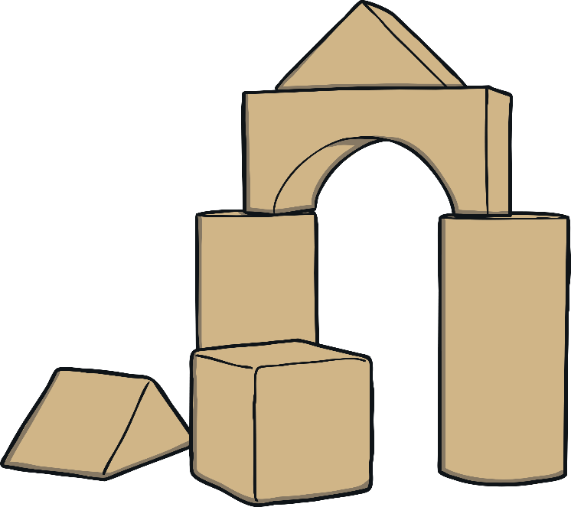
Is It Old or New?
old
new
next

Slide 19

Is It Old or New?
old
new
next

Slide 20
Is It Old or New?
old
new
next

