Slide 2
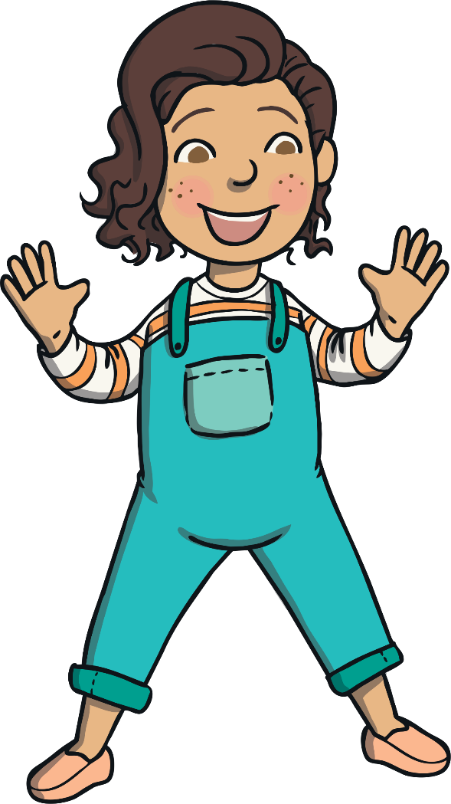
What Am I?
Can you follow the clues to work out what is being described?
SLEDI NAMIGOM IN UGOTOVI, KATERA IGRAČA JE OPISANA.
Click on the ball to reveal each clue!
KLIKNI NA ŽOGO ZA NOV NAMIG!

Slide 3
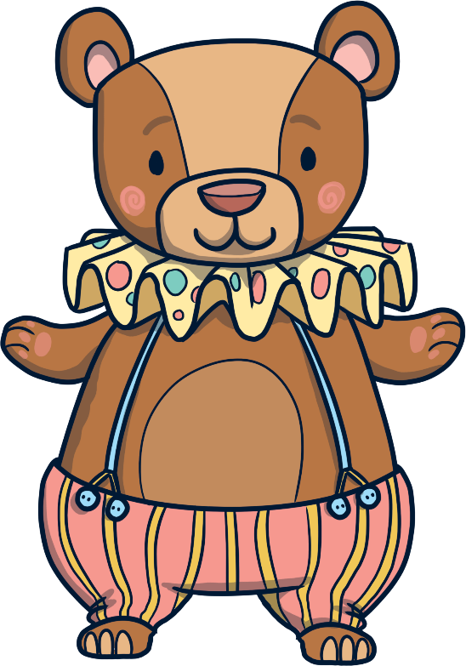
What Am I?
I am a teddy bear!
I am soft. Sem mehak.
You might cuddle me. Lahko me cartaš.
I have two arms and two legs. Imam dve roki in dve nogi.
What am I? Kdo sem!
Click on me to reveal the answer.
Start
Next

Slide 4
What Am I?
I am a ball!
I am soft. Sem mehka.
You can play with me. Z menoj se lahko igraš.
Thay play football or basketball with me. Z menoj igrate nogomet ali košarko.
What am I? Kdo sem?
Click on me to reveal the answer.
KLIKNI NAME ZA ODGOVOR.
Previous
Next

Slide 5
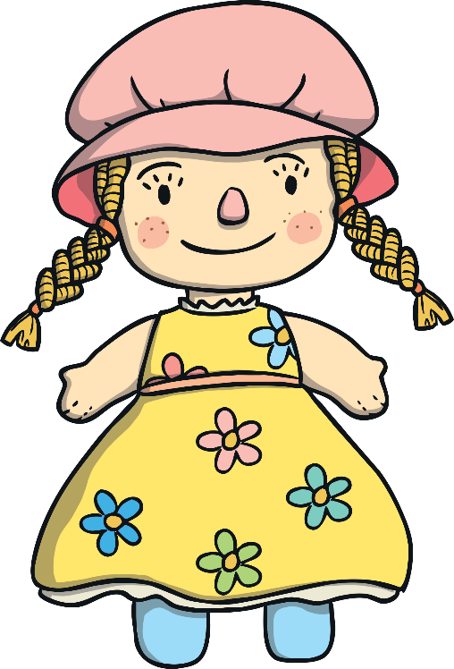
What Am I?
I am a doll!
I look a bit like a person. Izgledam kot človek.
I am soft. Sem mehka.
I have woollen hair. Moji lasje so iz volne.
What am I? Kdo sem?
Click on me to reveal the answer.
Previous
Next

Slide 6
What Am I?
I have four wheels. Imam 4 kolesa.
I am a car!
I am usually made from metal or plastic. Sem iz kovine in plastike.
I come in lots of different colours. Sem različnih barv.
What am I? Kdo sem?
Click on me to reveal the answer.
Previous
Next

Slide 7
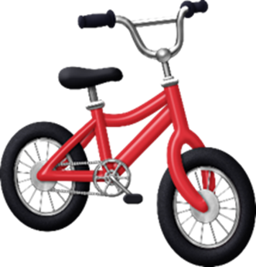
What Am I?
I am a
bike!
Usually I am made from alluminium. Ponavadi sem iz aluminija.
You can drive with me. Z menoj se lahko pelješ.
I have two wheels. Imam dve kolesi.
What am I? Kdo sem?
Click on me to reveal the answer.
Previous
Next

Slide 8
What Am I?
I am a guitar!
I am made from wood. Sem iz lesa.
I can play music. Lahko igram glasbo.
I have strings. Imam strune.
What am I? Kdo sem?
Click on me to reveal the answer.
Previous
Next

Slide 9
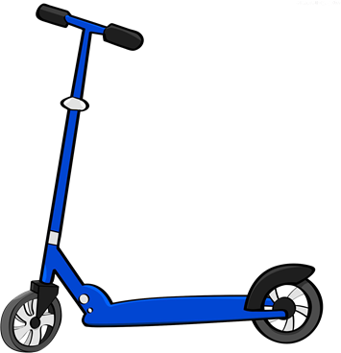
What Am I?
I am a scooter!
I have two wheels. Imam dve kolesi.
I am usually made from metal or plastic. Sem iz kovine ali plastike.
I am quite small. Sem pretežno majhen.
What am I? Kdo sem?
Click on me to reveal the answer.
Previous
Next

