Slide 1
FARM ANIMALS
PART TWO

Slide 2
LET‘S MEET SOME MORE FARM ANIMALS …

Slide 3
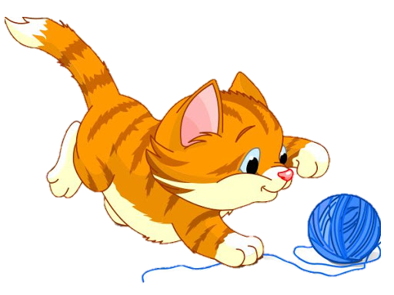
A CAT

Slide 4
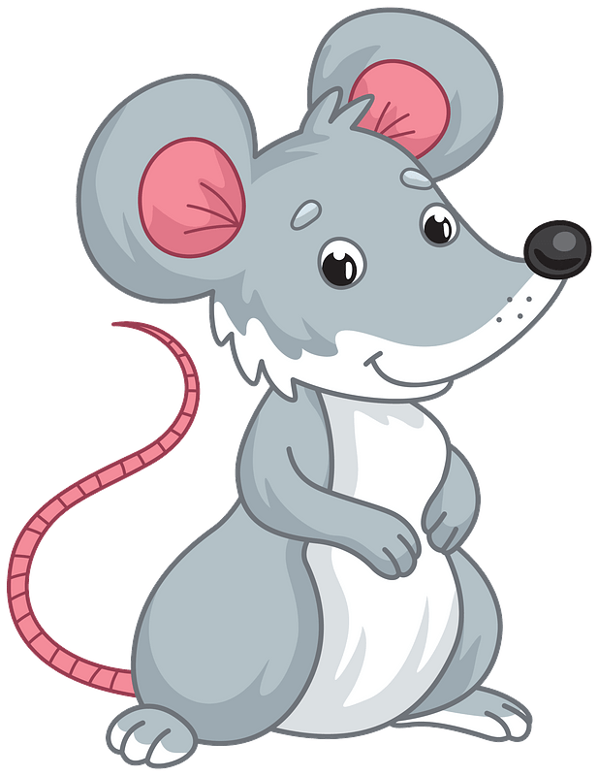
A MOUSE

Slide 5
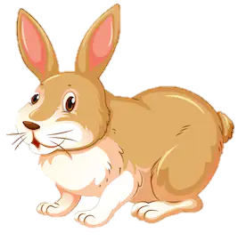
A RABBIT

Slide 6
A TRACTOR

Slide 7
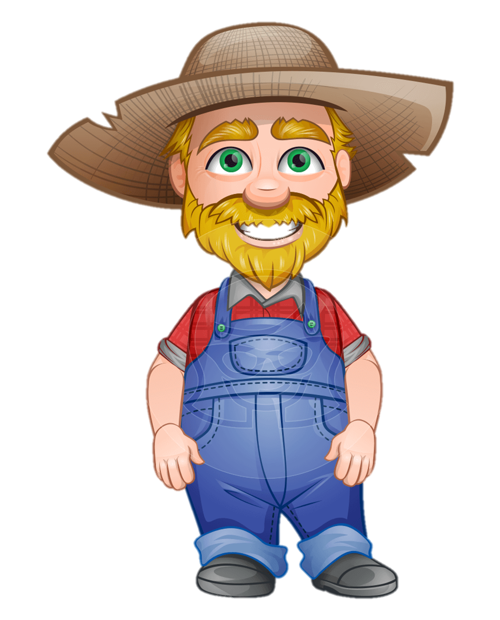
A FARMER

Slide 8
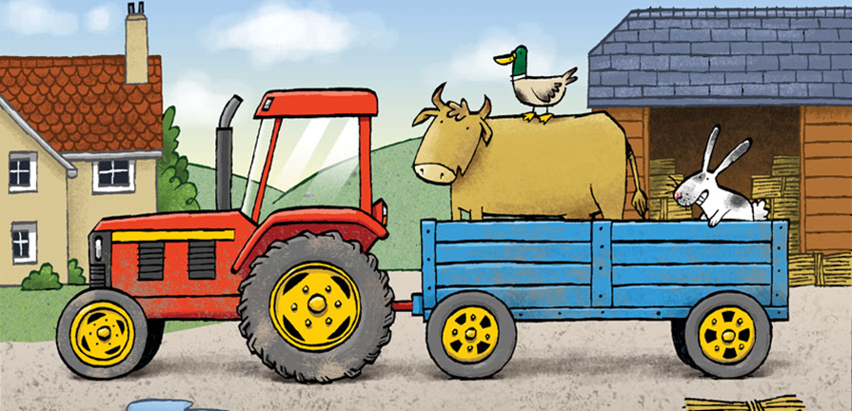
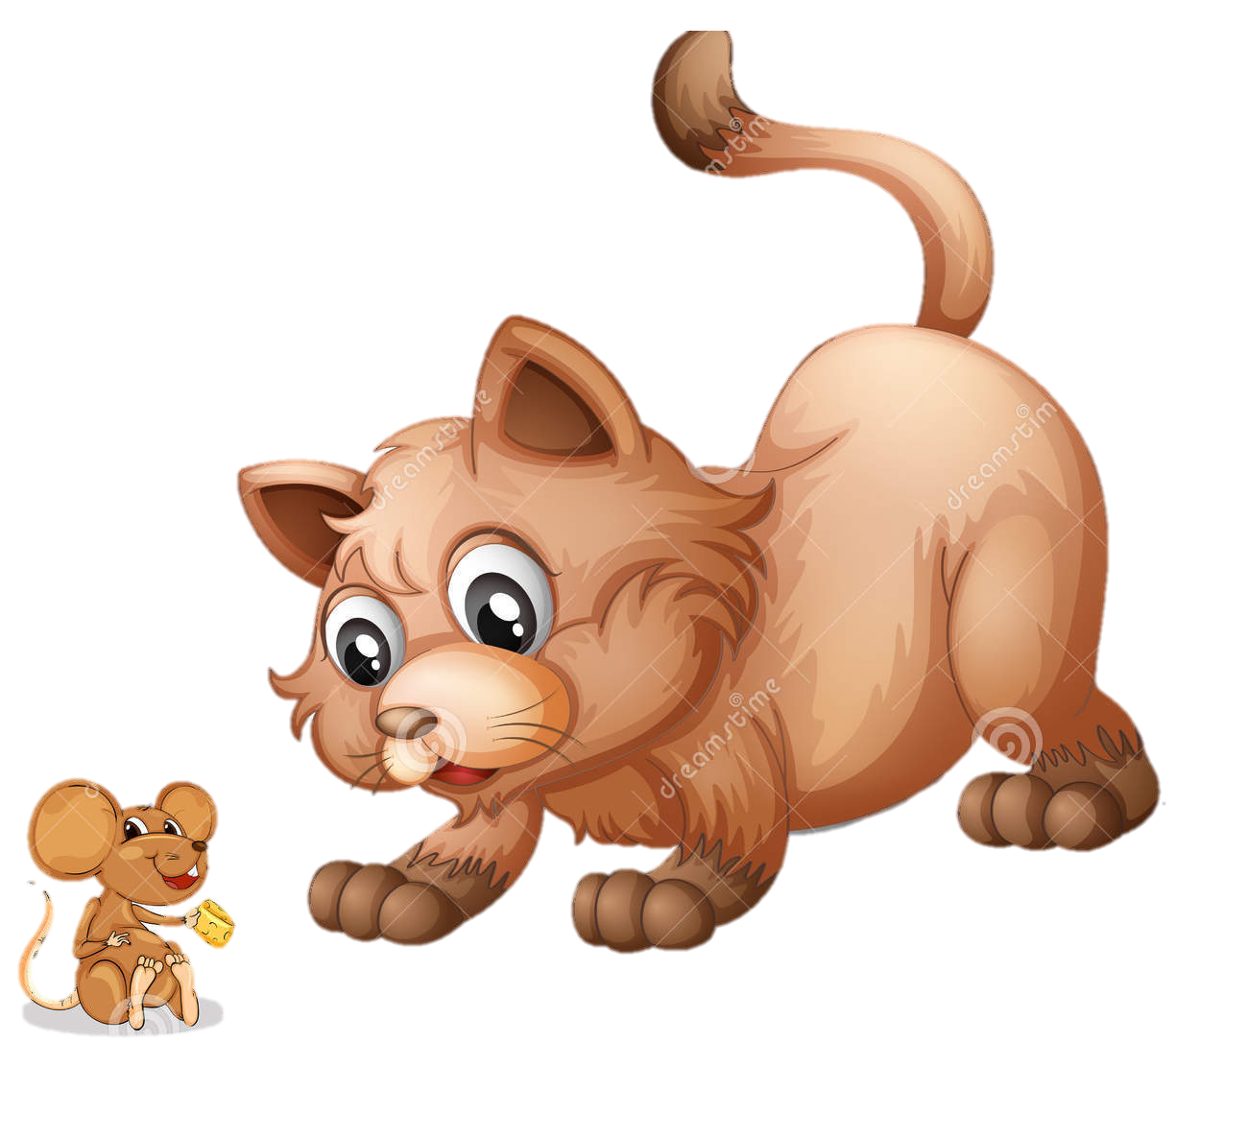
What can you see? Point at, repeat after me, which color is… ?

