Slide 1

Where we live
5. RAZRED
OŠ Šmarje pri Kopru
šol. leto 2021/2022
učiteljica Ena Bissachi

Slide 2





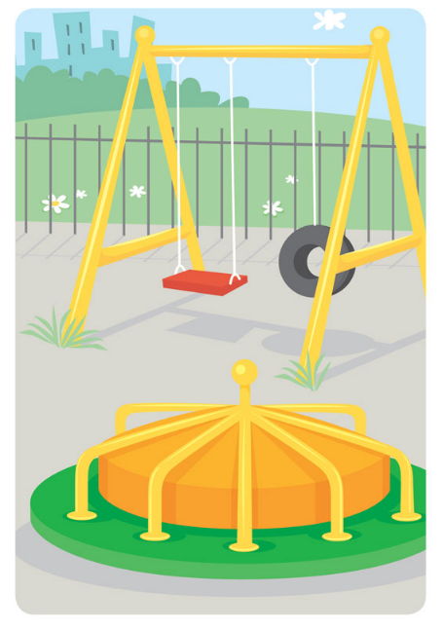

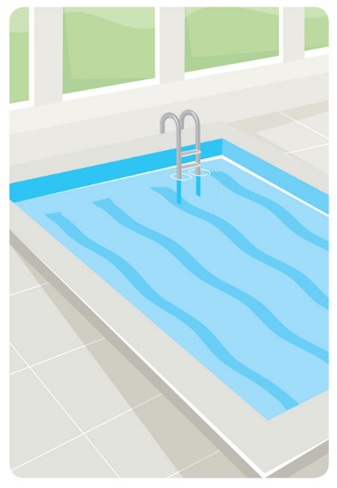


WHAT CAN YOU SEE IN THE PICTURES?

Slide 3

WHAT CAN YOU SEE IN THE PICTURES?

