Slide 2
MOTHER mama

Slide 3
FATHER oče

Slide 4
BROTHER brat

Slide 5
SISTER sestra

Slide 6
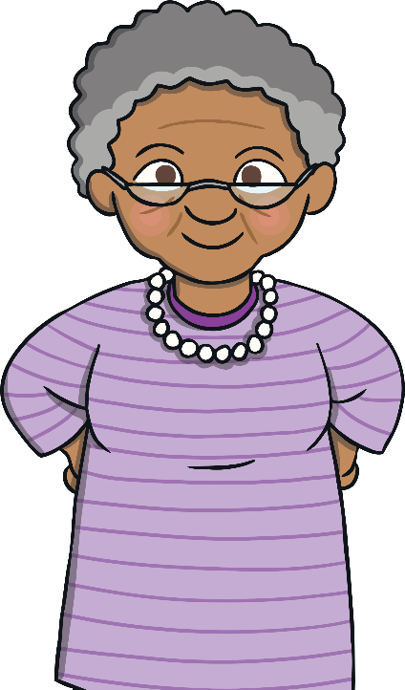
GRANDMOTHER babica

Slide 7
GRANDFATHER dedek

Slide 8
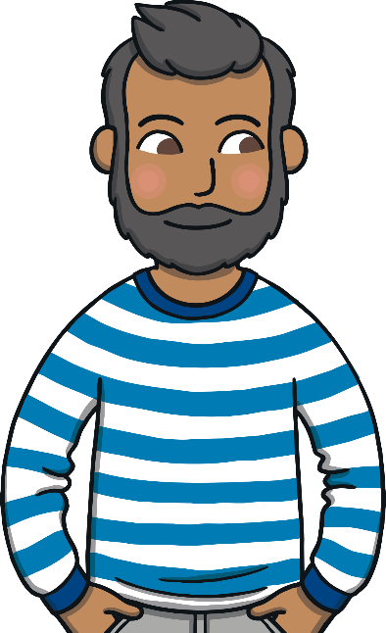
UNCLE stric

Slide 9
AUNT teta

Slide 10
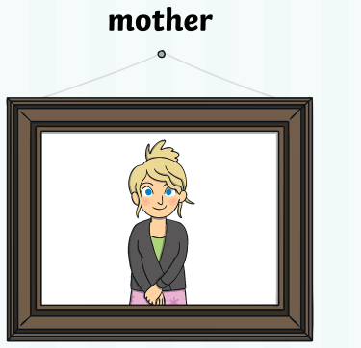
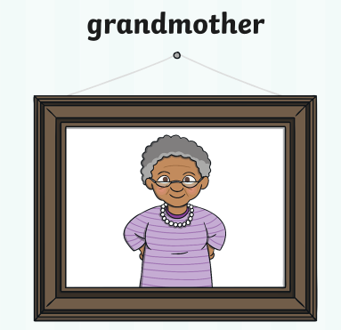
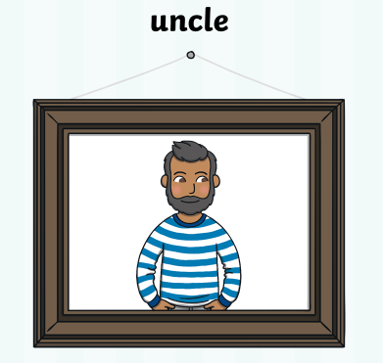
LISTEN AND POINT. PRISLUHNI IN POKAŽI.

Slide 11
LISTEN AND SAY. PRISLUHNI IN POVEJ.

