Slide 2

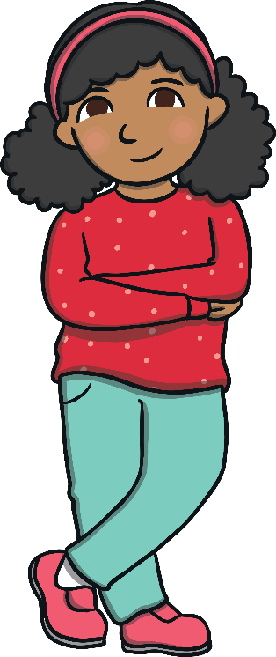

Select the Correct
Personal Pronoun
he
I
she

Slide 3
Select the Correct
Personal Pronoun
he
she
I

Slide 4
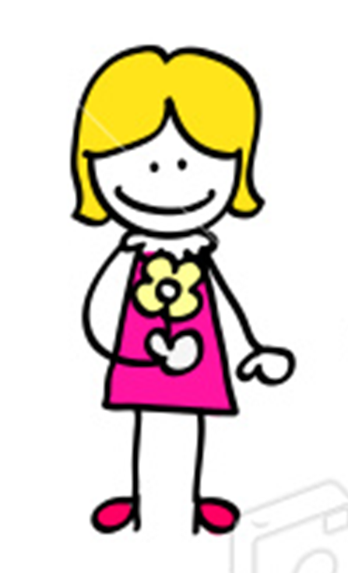
Select the Correct
Personal Pronoun
he
she
I

Slide 5
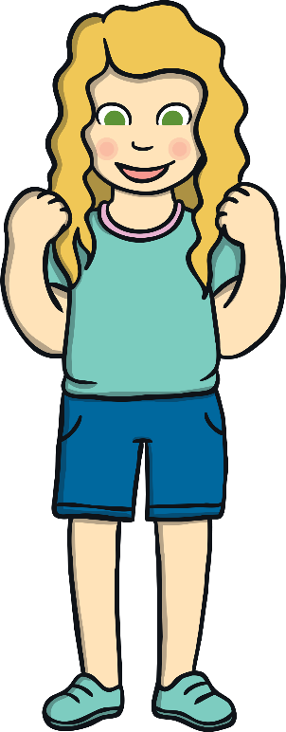
Select the Correct
Personal Pronoun
she
he
I

Slide 6
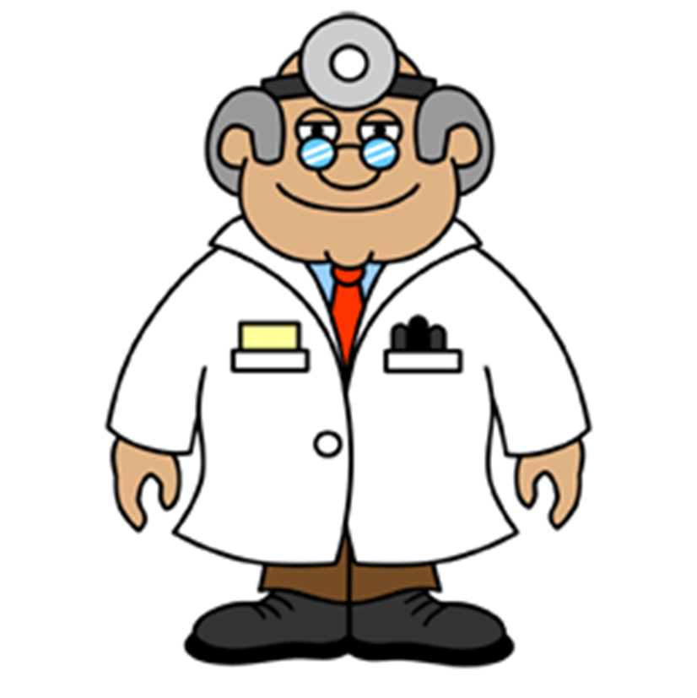
Select the Correct
Personal Pronoun
I
she
he

Slide 7
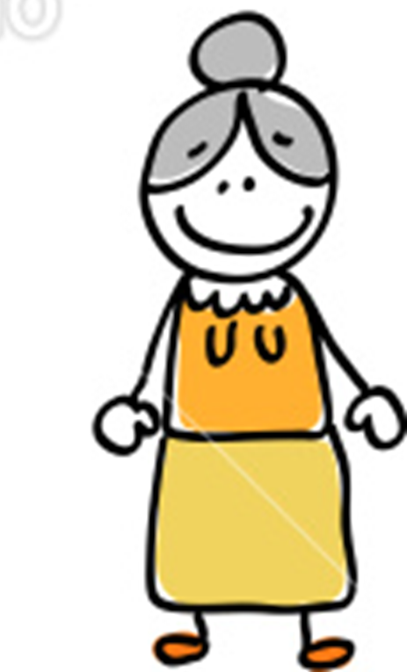
Select the Correct
Personal Pronoun
he
I
she

Slide 8
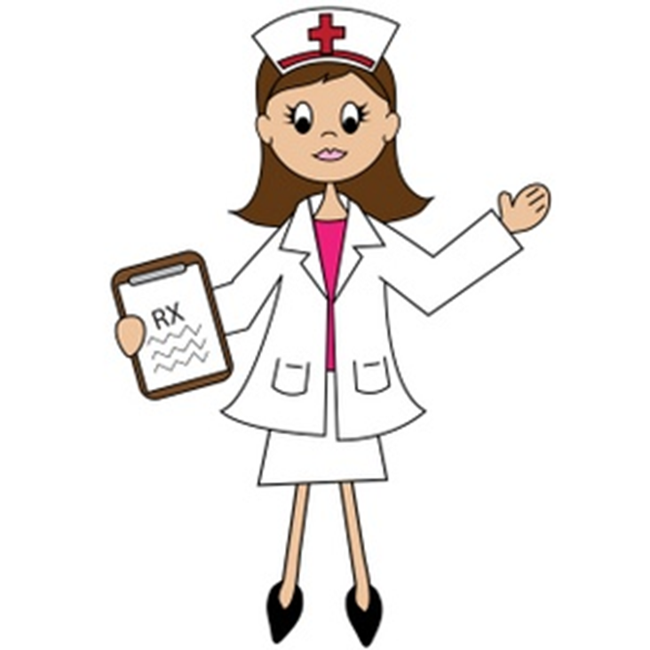
Select the Correct
Personal Pronoun
he
I
she

Slide 9
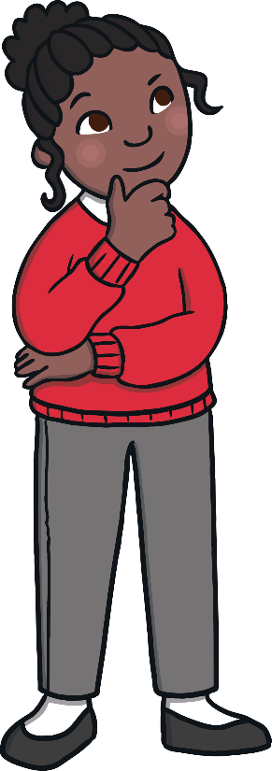
Select the Correct
Personal Pronoun
he
she
I

Slide 10
Select the Correct
Personal Pronoun
he
she
I

Slide 11
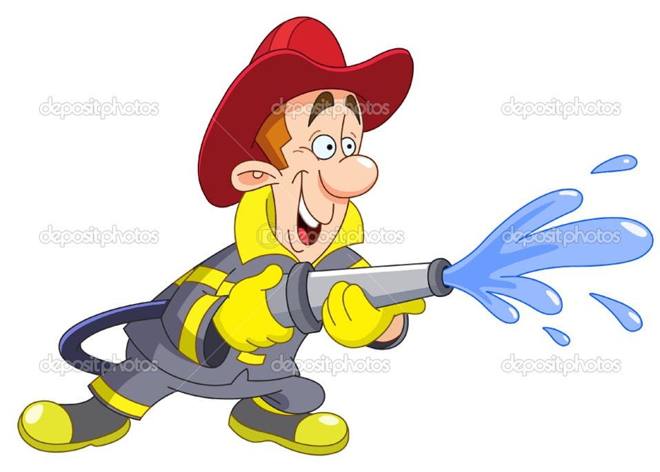
Select the Correct
Personal Pronoun
I
she
he

Slide 12
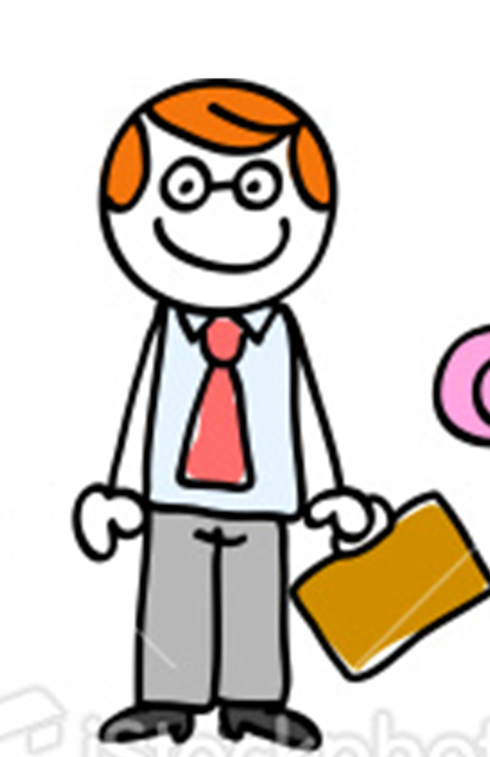
Select the Correct
Personal Pronoun
I
she
he

Slide 13

Select the Correct
Personal Pronoun
he
I
she

Slide 14
Select the Correct
Personal Pronoun
I
he
she

Slide 15
Select the Correct
Personal Pronoun
he
she
I

Slide 16

Select the Correct
Personal Pronoun
he
I
she

